Slide 1


Cornwall Destination Review
Cultural Workshop
November 2015

Slide 2
Objectives
Demonstrate the potential business that cultural activity and communication will bring to Cornwall
Notes:
Objective: To bring a set of key hospitality and cultural organisation owners, managers and marketing personnel together and inspire them into action in their companies/organisations after opening their eyes to the potential business that cultural activity and communication will bring
We have been working with Visit Cornwall and C365 over the last 6 months or so to determine perception & awareness of Cornwall, and how the cultural offer can fit into this moving forwards …

Slide 3
Areas we will cover today …
Context …
  Domestic Tourism
  Cultural Tourism
Perceptions of Cornwall as a Cultural Destination
Actions undertaken by Suppliers
Communicating the Offer

Slide 4
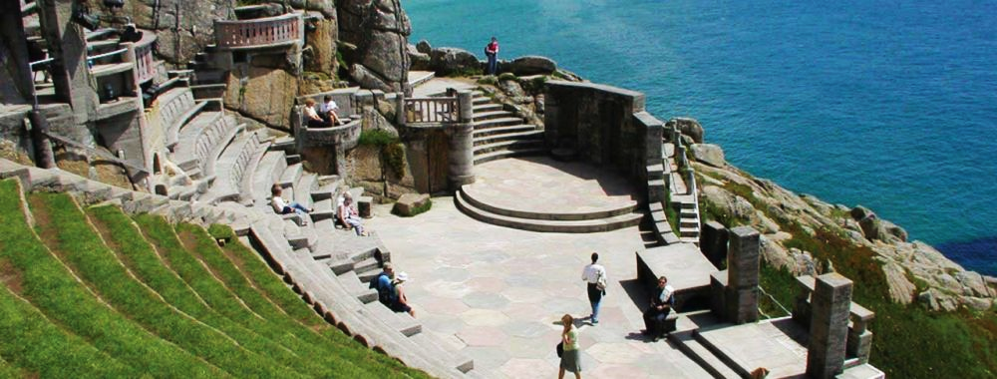
Context

Slide 5
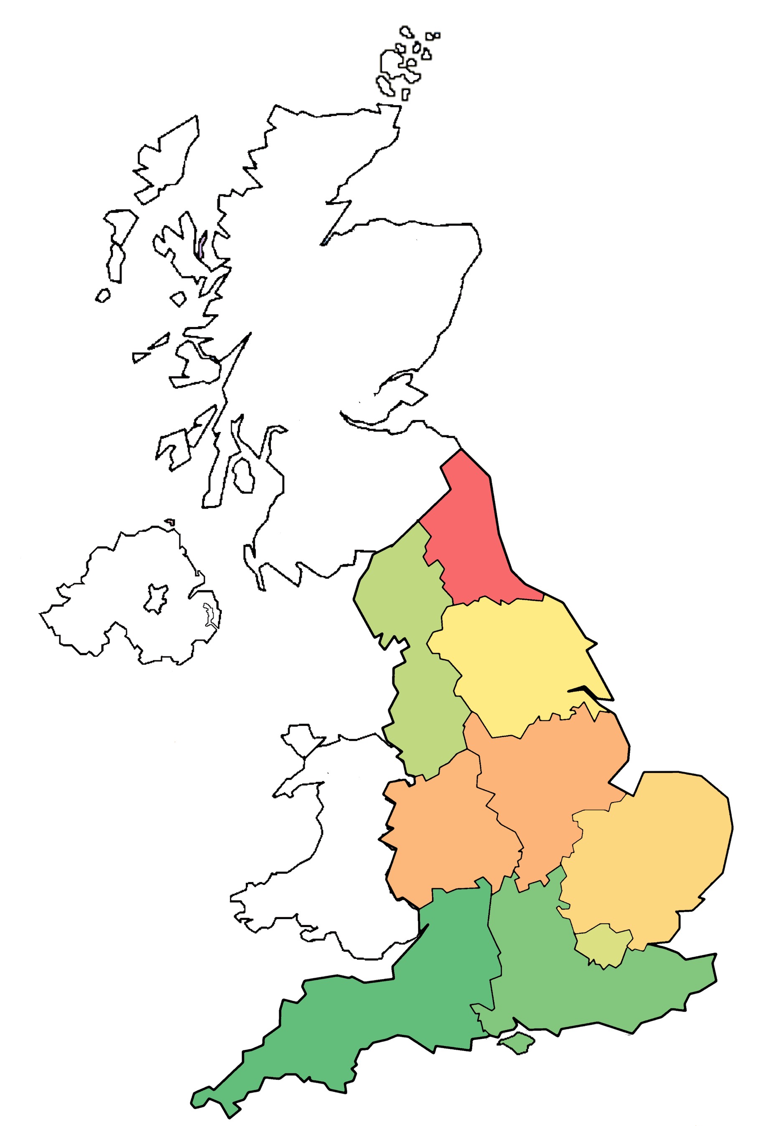
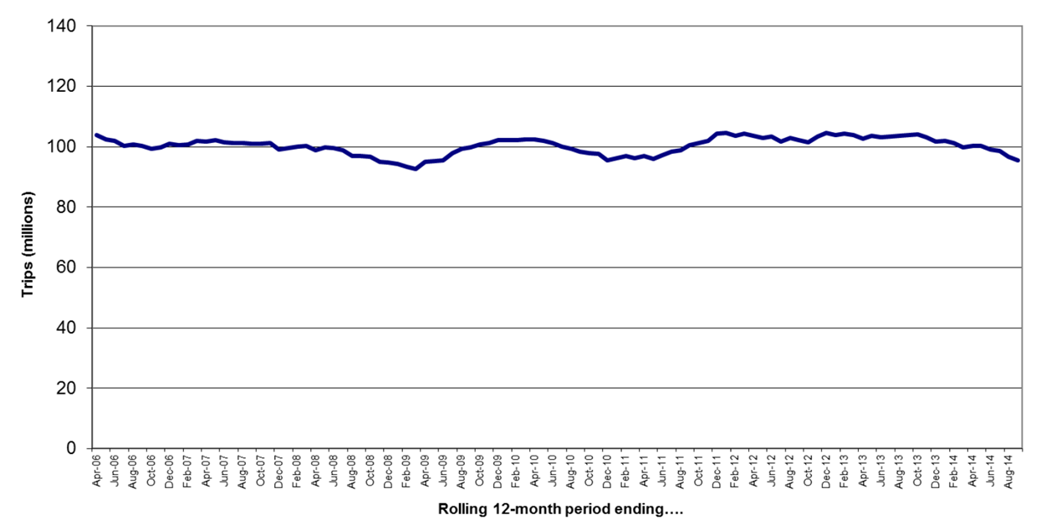
Domestic Tourism
Region | Number of trips (millions) (October 2013-September 2014 | Percentage change on previous year
South West | 17.916 | 4.4%
South East | 16.385 | 10.8%
North West | 13.268 | 5.4%
London | 11.866 | 6.2%
Yorkshire | 10.045 | 4.3%
East | 9.073 | 4.2%
West Midlands | 7.504 | 17.3%
East Midlands | 7.3 | 11.1%
North East | 3.52 | 13.3%
Source: Visit England
Notes:
The Challenge …. Domestic Tourism is falling after some years of growth (Staycation)
THE POSITIVE … SW is still the leading destination … and decline is less than other areas of the UK

Slide 6
UK holidays
Type of holiday taken | Proportion
A city break | 43%
A beach holiday | 30%
Lakes and mountains | 10%
A trip to see a music event | 9%
An activity of sporting holiday | 8%
Source: ABTA consumer trends survey 2014
Notes:
CHALLENGE: City Breaks are the main UK holiday being sought … our research shows that this is because cities are seen to offer more for your money in terms of lots of things to see & do in a relatively short period of time
CHALLENGE … Cornwall has to get the message across that

Slide 7
UK holidays taken
Short breaks (1-3 nights)
80%
Proportion that have taken a short break in the UK over the last 12 months
23%
Proportion that have taken a short break to the South West in the last 12 months
13%
Proportion that have taken a short break to Cornwall in the last 12 months
Notes:
Short breaks are by far the most popular holiday type taken in the UK over the last 12 months with 80% taking at least one.
They are especially popular amongst the younger independent market with the proportion increasing to 84%.
When looking at the Arkleisure segments, Style Hounds and Cosmopolitans show the greatest proportion.
In terms of Cornwall, 13% took a short break here in the last 12 months.
As a proportion of total trips this is lower than for that of mid-length trips and longer holidays.

Slide 8
UK holidays taken
Mid-length breaks (4-6 nights)
33%
Proportion that have taken a mid-length break in the UK over the last 12 months
13%
Proportion that have taken a mid-length break to the South West in the last 12 months
8%
Proportion that have taken a mid-length break to Cornwall in the last 12 months
Notes:
Mid-length breaks were taken by 33% of the public during the last 12 months, making them far less popular than the short break and just slightly more popular than the longer week plus holidays.
It is families who find these breaks most attractive and the young independents (who favoured short breaks the most) finding these of least interest.
In terms of segment, High street (37%) and again Cosmopolitans (36%) are most interested.
8% have been on a mid-length break to Cornwall in the last 12 months.

Slide 9
UK holidays taken
Long breaks (7+ nights)
25%
Proportion that have taken a long break in the UK over the last 12 months
10%
Proportion that have taken a long break to the South West in the last 12 months
7%
Proportion that have taken a long break to Cornwall in the last 12 months
Notes:
Long breaks, by their nature, are taken far less regularly than short breaks. In the last 12 months a quarter of the UK went on a long break.
In a similar trend to the mid-length trip, families find this type of holiday most appealing with young independents again showing their preference is strongly towards the short break.
In terms of Arkleisure, the more risk averse segments appear to favour the long UK break with Habituals the stand out favourites with 36%.
Cornwall attracted 7% of the UK down for a long break in the last 12 months. Compared to the proportion that took this type of holiday anywhere in the UK, it shows Cornwall to be a more popular destination for longer breaks compared with competitors than for shorter and mid-length breaks against rival destinations.

Slide 10
Regions visited by length
Notes:
The short break is a popular getaway when visiting London. There is a lot to see and do in the area so a short break can be enough time to see/do many different attractions.
All destinations have a higher proportion of short break visits, with over 50% in all parts of the country making up visitors.
For the long break (7+ nights) the South West is shown to be slightly favourable with 22% of visits being categorised by this length.
COMPETING AGAINST LONDON FROM A CULTURAL PERSPECTIVE …
Museums & Galleries throughout the UK in 2014 saw a 6.1% increase in visitor numbers from 2013, compared to 11.8% in London.
Blockbuster exhibitions continued to boost visitor numbers – with Tate Modern welcoming a record 5,785,427 – which was undoubtedly helped by the Matisse exhibition.
In many cases the amount of domestic visitors has remained the same or decreased, but not those from overseas who continue to visit Britain in large numbers in a post-Olympics and Commonwealth Games tourism boom.
Museums and galleries have become masters of the mega-blockbuster: big, once-in-a-lifetime exhibitions like Matisse at Tate Modern or Rembrandt at the National Gallery that become must-see attractions.
The vast majority of museums and galleries in the UK have developed excellent education departments over the last decade, who help shape the content towards schools and students.

Slide 11
Cultural tourism
Visit Britain defines cultural tourism as ‘‘Visits to enjoy visual and performing arts, museum, galleries, heritage attractions, artists’ open studios, art fairs, auctions, public art and architecture, festivals, films and other cultural events.’
These visitors want to “enjoy exhibitions and performances, to sample local food and learn about local customs, to enjoy the atmosphere of a place and to learn something. They enjoy experiences that fire their imagination or offer a chance to connect with the past”.
These definitions identify a wide range of potential people who fall into this category of cultural tourists.
Cultural tourists are notoriously hard to identify because of the slippery nature of culture itself. We could be talking about material culture, for example an art collection or a building. Or we might be thinking of behaviours including traditions and lifestyle choices. These can be universal cultures or those very specific to place. (Cornwall 365, 2014)
Cultural tourists can be classified into those who like everyday culture, popular culture or those into high culture.
Notes:
Cultural tourism is perceived as a growing market.
Figures from the World Tourism Organisation indicate that the proportion of international trips accounted for by cultural tourists grew from 37% in 1995 to 40% in 2004. Although this seems a small increase, the large growth in global tourism volumes means that by 2009 there were around 375 million international cultural trips.
Cultural tourism is generally seen as a high spending market, usually undertaken by highly educated individuals who stimulate cultural activity in the destination. Therefore, this market is seen as highly valuable to a destination.
Sought after by destinations … When asked what forms of tourism they would like to see developed in future, over 90% of Barcelona residents indicated that they would prefer to develop cultural tourism as a growing market.

Slide 12
Combining ‘high’ and ‘popular’ culture
Passive
Active
Consumption
The graph shows how cultural tourism overlaps with other types of tourism and how it has a wide range of appeal through everyday culture to high culture.
The consumption element describes how a tourist may interact.
  Passive would be through the means of media, putting little effort into the interest. Where as active suggests they will go to specific places for that interest.
High culture
Heritage tourism
Arts tourism
Creative tourism
Cultural tourism
Popular culture
Production
Crafts tourism
Everyday culture
Source: Tourism trends-The convergence of culture and tourism
Notes:
BUT FROM THE CONSUMER PERSPECTIVE …
Cultural tourism evoked thoughts of a focus on the performing arts, galleries and possibly museums. Only a small minority would see themselves as a ‘cultural tourist’. People often describe this as ‘high-culture’ and it alienates more people than it appeals to. (Visit Wales)
Most people fall into a POPULAR culture band that does involve visits to museums / art galleries
Popular culture tourism revolves around those that visit a destination based on music events, film or TV-sets or literary locations.
Britain is ranked 4th out of 50 nations in terms of having an interesting /exciting contemporary culture such as music, films, art and literature(NBI, 2009),
Although the impact of films and television is normally temporary it usually encourages an increase in visitor numbers for at least some time. It may not play the main role in a visit to a destination but may act as a one of many reasons to visit.
The popularity of these destinations has been seen worldwide:
Lord of the Rings (New Zealand)
The Beach (Thailand)
Even in the UK, certain destinations have seen a growth in visitor numbers based on popular culture:
The Beatles (Liverpool)
Robin Hood (Nottingham)
Harry Potter (London)
Doctor Who (Wales)

Slide 13
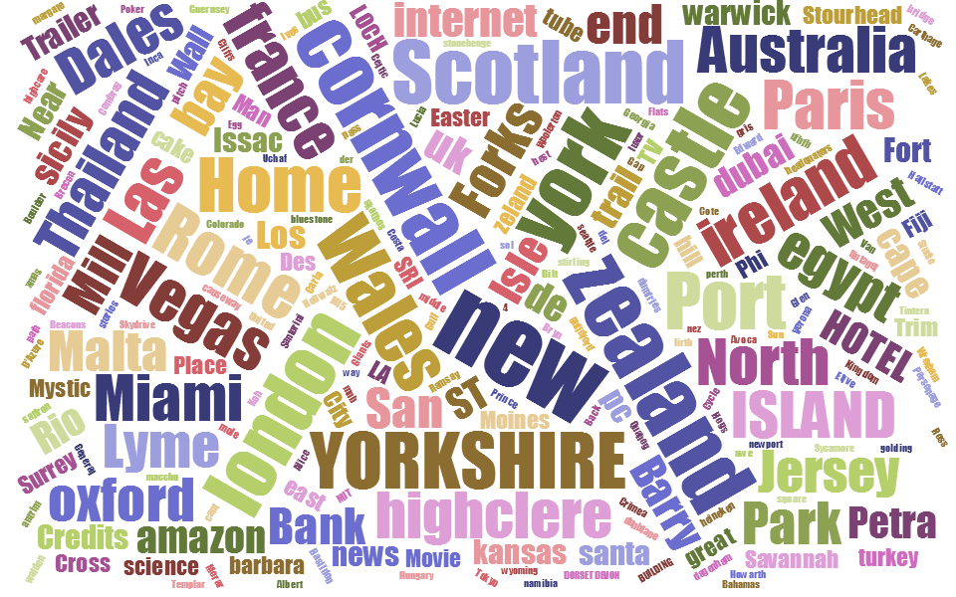
Where do people look up
The word cloud on the left shows the proportions of destinations and attractions that are looked up after seeing something on television or reading about it.
Cornwall proves to be one of the most looked up destinations.
Source: Wales Film Tourism 2013
Notes:
As an example of the effect of popular culture tourism, we can show results from a study done for Wales Film Tourism in 2013.
24% of the market say that they have visited a place after seeing it or reading about it.

Slide 14
The five types of cultural tourist
Purposeful cultural tourist: for these highly motivated and early adopters, culture is their main reason for choosing a destination. They want a deep cultural experience
Sightseeing cultural tourist: culture is one of the main reasons they visit, but their experience of it is not as deep. They might be business tourists, students or knowledge tourists
Serendipitous cultural tourist: don’t travel specifically for culture but are interested in seeking out experiences and, ultimately does have a deep cultural experience.
Casual cultural tourist: culture is not a motivation for their visit and as a result they don’t have a deep cultural experience.
Incidental cultural tourist: this type of tourist does not travel for culture, but does engage in some very light touch cultural experiences.
Source: McKercher B and H du Cross, Cultural Tourism: The partnership between tourism and cultural heritage management (2002).
Notes:
There have been some quite academic attempts at understanding the cultural tourist better …
… but how do you go about targeting this sort of visitor?

Slide 15
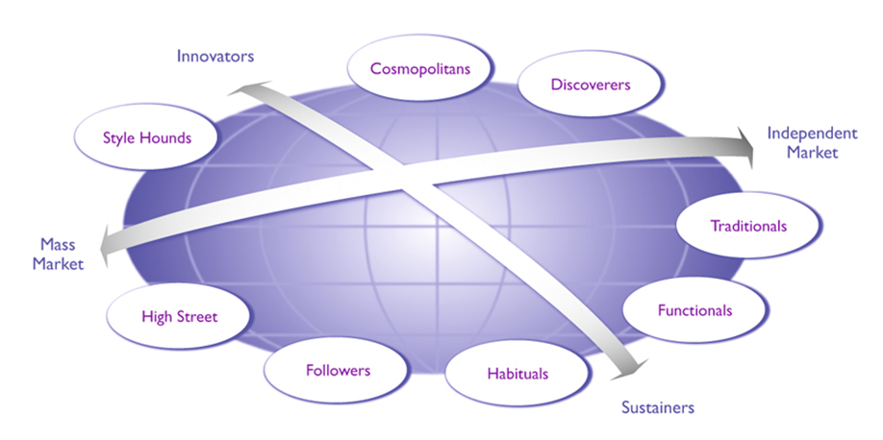
Our view of the market - ArkLeisure
Notes:
Whole market segmentation based on what motivates people to do LEISURE ACTIVITIES
More importantly … leisure activities / experiences that they are prepared to pay for
This includes Cultural as well as other types of experience

Slide 16
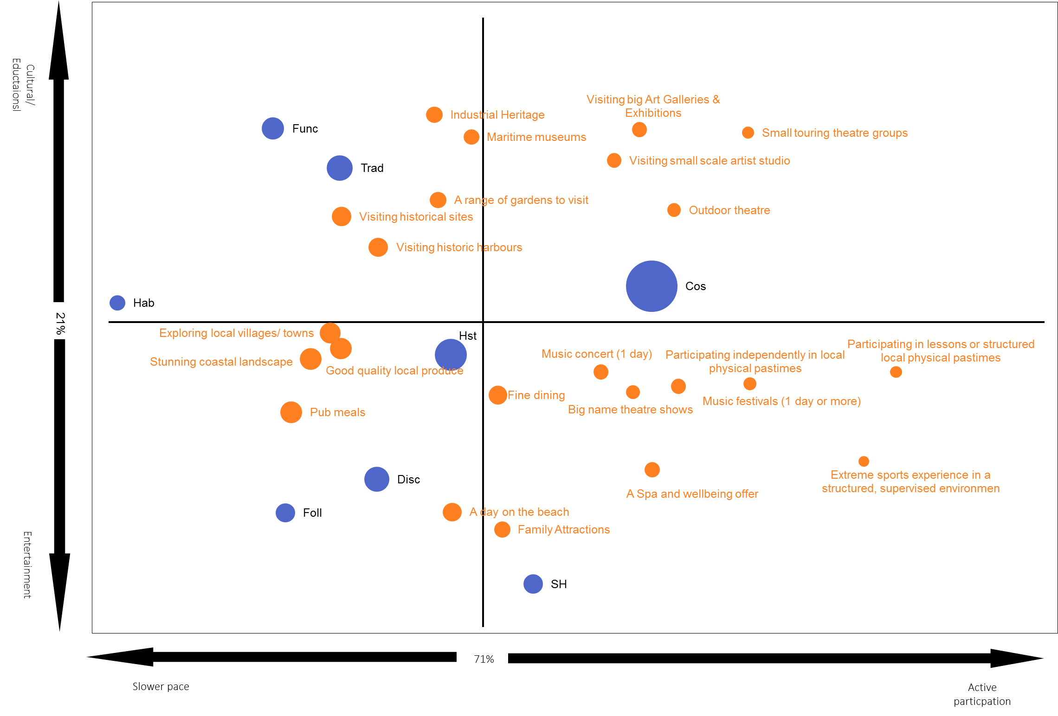

UK leisure break activities by segment
The chart helps to show the traits of each of the Arkleisure segments.
We can see that Functionals and Traditionals lean towards the slow paced attractions which offer some culture and education.
  E.g. Historical sites, historical harbours etc.
Style Hounds are probably the most opposite segment to these traits. They prefer entertainment over education and want to be more actively involved.
  E.g. Family attractions, a day on the beach etc.

Slide 17
Who is visiting Cornwall?
Recent – Visited last 12 months
Lapsed – Visited 1-5 years ago
Past – 5+ years ago
Notes:
Looking solely at Cornwall, we can see a few of the segments prefer the offer more than others. This is the case for Habituals, Traditionals and Cosmopolitans.
However, Habituals and Traditionals are made up of a large proportion of visitors who have not visited Cornwall in the past 5 years.
Cosmopolitans, High Street and Style Hounds have the greatest proportion of visitors who have been in the past 12 months.
For lifestage, naturally older independents are more likely to have visited ever but again a large proportion of these has not been recently.
31% of families have however visited Cornwall in the last 12 months.

Slide 18

Segmenting visitors
Cornwall already attracts a good proportion of Cosmopolitans, Discoverers and Functionals.
  More than the proportion for the National Population
The Traditional segment is one area where an improvement could be seen.
  Currently make up only 7% of visitors to Cornwall.
From the previous slide we saw that Traditionals have at least some interest in history and heritage.
Cultural tourists
Source: Annual Cornwall Visitor Survey 2012-2015

Slide 19
Perceptions of Cornwall as a Cultural Destination

Slide 20

Destination Awareness
Most people have an idea about what destinations have to offer …
  Most destinations have an image or reputation / stand out for offering certain types of trip
Awareness is in the main built up over time, and comes from numerous sources
  Word of mouth, news articles, adverts & pictures, newspaper articles, etc.
As this ‘opinion’ already exists, it means that there are very few ‘blank canvas’ searches being made for destinations
Awareness is in effect the appeal or consideration factor
But it isn’t the decision factor
The decision is made during the customer journey

Slide 21
Trigger for Holiday
This stage of the journey is very personal
It is very linked with awareness
It is forever being informed from online and offline sources
The triggers change depending on lifestage / workloads / expendable income / tastes & fashions
The destinations for each trigger change dependent of how long they have got, how much money, and who they are travelling with
Sometimes specific destinations get mentioned, other times types of breaks or companies that offer this type of holiday. Sometimes it is a combination of all of these
This is the start of the journey that provides the destination set on which decisions are made

Slide 22
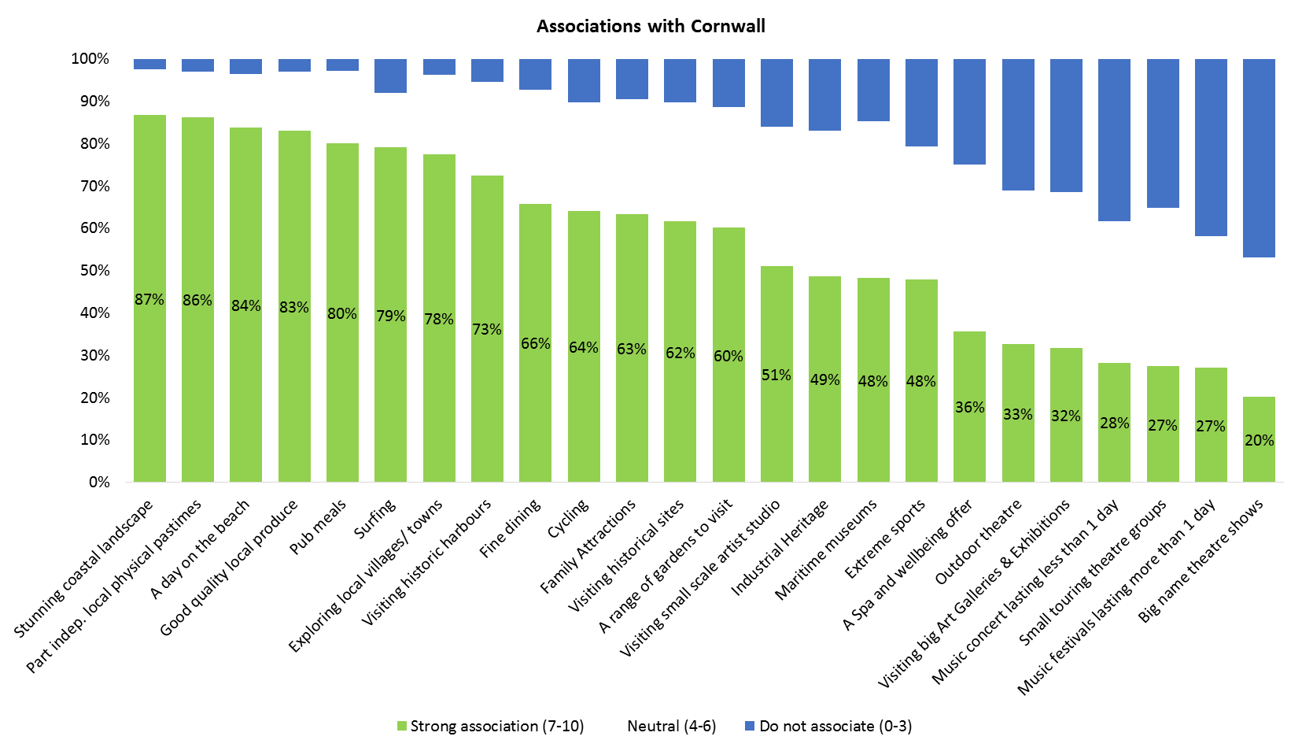
UK leisure break associations with Cornwall

Slide 23
What has changed in 5 years?
Arts & Culture and Industrial Heritage still low
Up 10% points
Up 8% points
Down 6% points

Slide 24
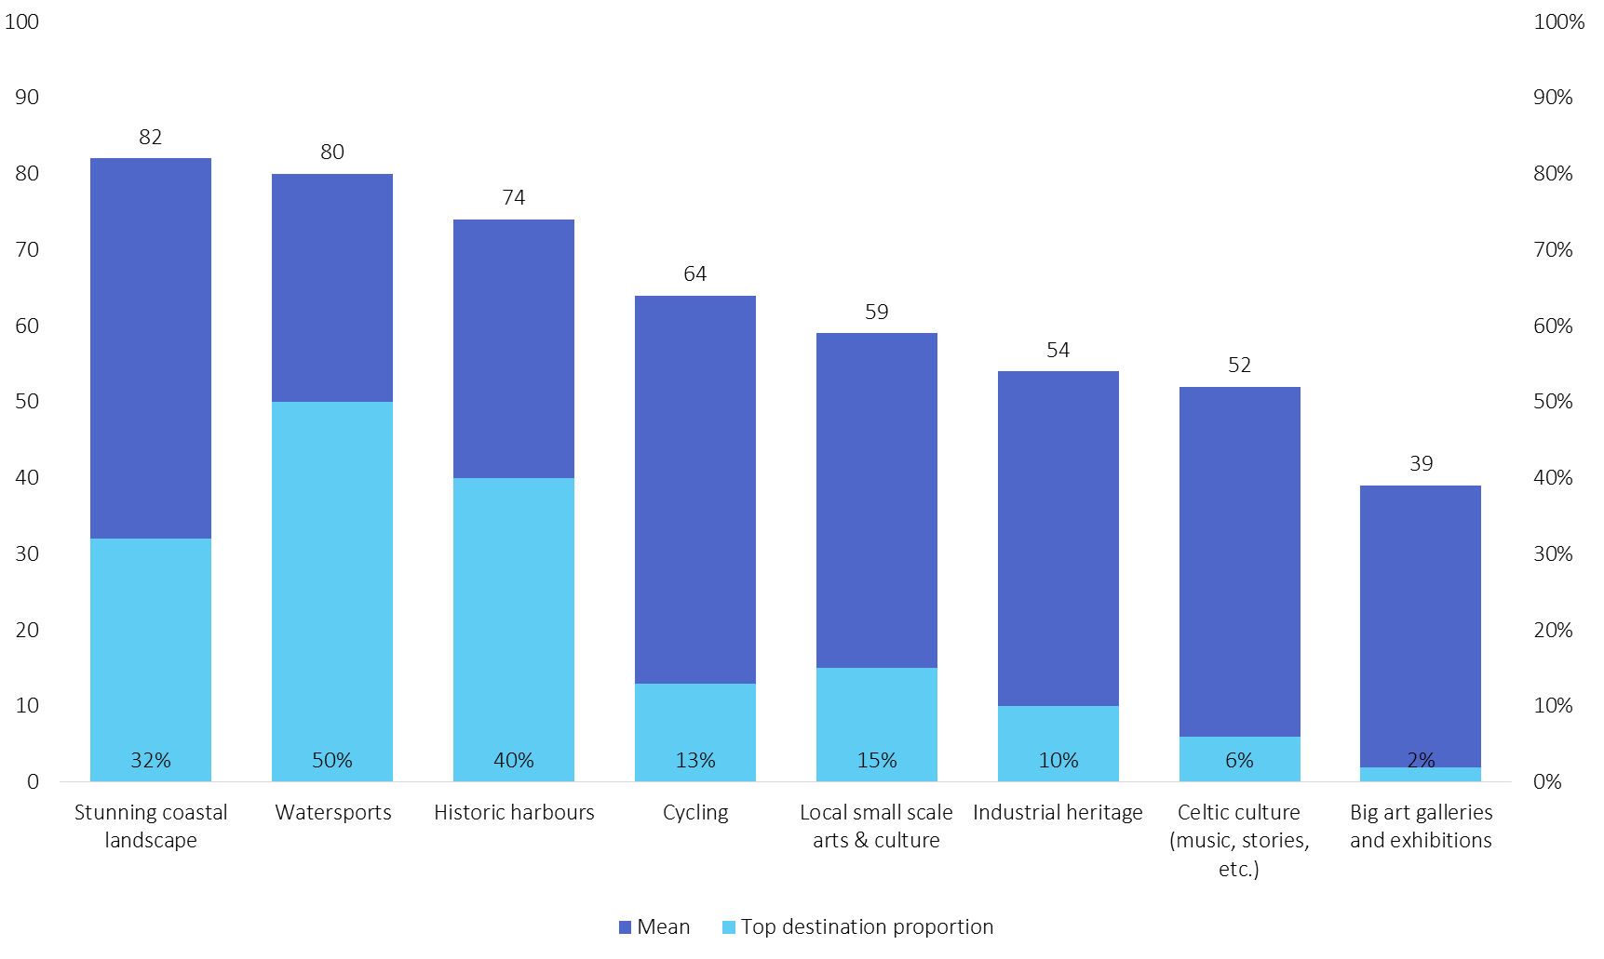
Cornwall competitive summary
Notes:
Cornwall performed best in 3 categories:
Stunning coastal landscape
Watersports
Historic Harbours
For other areas, such as small scale arts & culture, there looks to be potential to improve but awareness appears to be key.
Even though the mean score was only 59, 15% of respondents felt that it was the best destination for this attraction.
This is also an attraction type that does not have a stand out ‘best in class’.
Cornwall often has a flat profile suggesting that the majority of people do not know entirely about the offer so are sitting on the fence, but possibly leaning one way or the other.
Especially true for industrial heritage and Celtic culture.

Slide 25
Art galleries and museums
For those visiting Cornwall, 76% state they have an interested in art galleries and museums but would not describe it as the main reason they visit a place.
On a longer trip, they are more likely to have time to visit such a location. 56% stating they would be likely to visit an art gallery or museum when on a break longer than 4 nights.
Source: Tate St Ives Survey 2015

Slide 26
39% would visit Cornwall for arts and culture
Our sample associate Cornwall as a great destination for local artists and smaller independent studios with over 50% scoring these elements highly.
  Famous art galleries and famous work is not as well associated with Cornwall showing that the art and culture scene is perceived as a smaller more niche market in the county and stronger in certain areas.
  39% state that they would visit Cornwall for arts and culture.

Slide 27
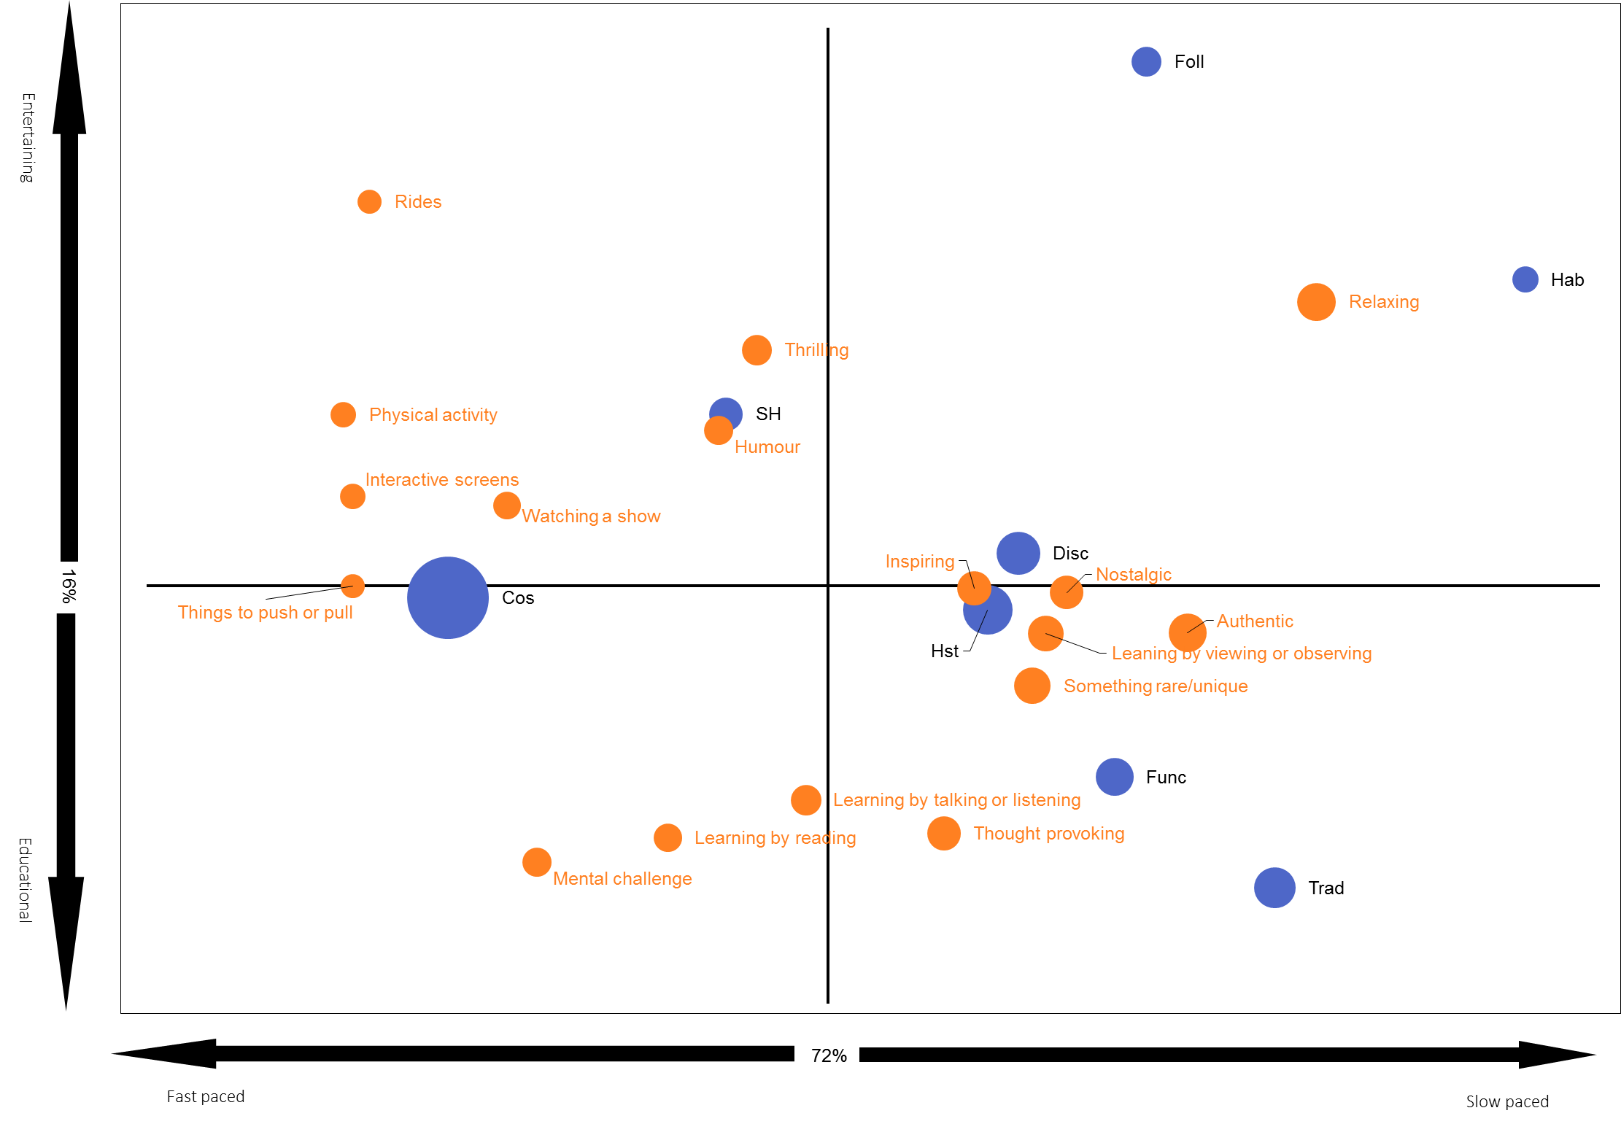
Attraction experience
When it comes to attraction experience we can see what each of the segments are looking for.
Traditionals and Functionals are pulled towards the bottom of the group where slow paced educational experiences are key.
Cosmopolitans like to be more involved with a split between learning and entertainment.
Style hounds, Followers and Habituals are the segments most likely to be after entertainment.

Slide 28
What do International cultural tourists want?
Visit Britain carried our a report in 2014 called ‘Leveraging our Heritage and Culture’ to determine current global perceptions of Britain's cultural heritage and look at how it can evolve to entice more visitors.
The research findings reporting that we already perform well on tangible and rational heritage and that over half (53%) of respondents state culture and heritage as their main motive for visiting Britain.
The interpretation of culture was broad, with respondents saying they wanted an experience that was unique to the destination, with 82% wanting to absorb Britain’s culture and heritage through ‘local markets’ and 81% via ‘local food and drink’.
The report also highlighted that there is a clear thirst for more information about how to explore more of Britain’s culture and heritage with suggestions of heritage-specific itineraries, based on different themes and regions of Britain.

Slide 29
Supplier Survey

Slide 30
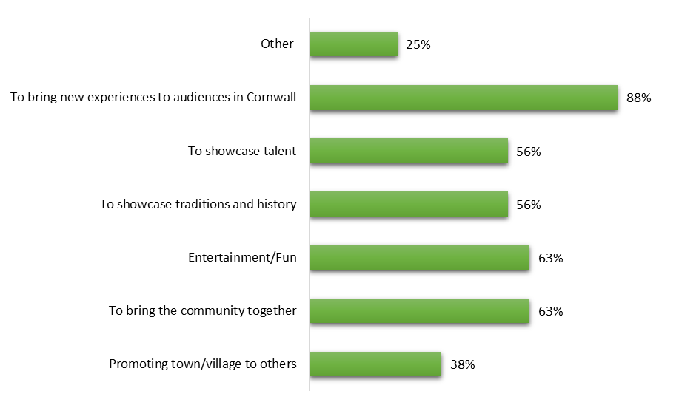
Main aim of your work
To advance the arts
To inspire and engage audiences
Connect us with each other and the living world
Heritage led regeneration by attracting capital investment into Cornwall and west Devon
Notes:
Pleasingly a core role described by organisation ties in with the strategy … to bring new experiences to Cornwall

Slide 31


Visitor Numbers
The estimated visitor numbers range from:
500
1,000,000
Tourists
57%
Locals
43%

Slide 32
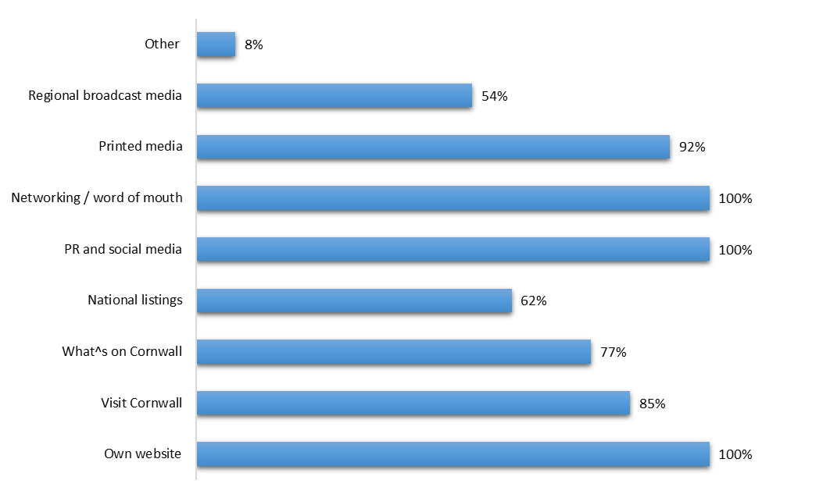
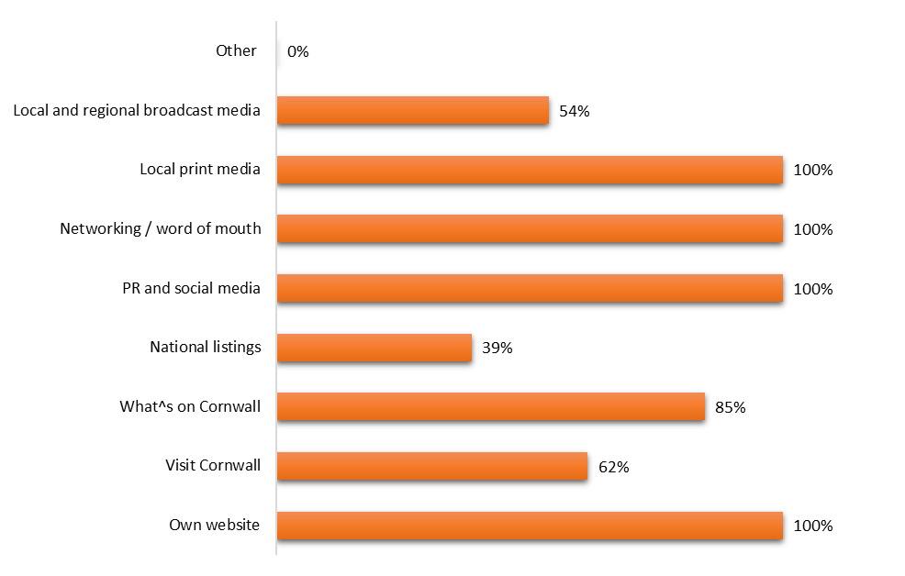
Marketing Tactics
Tourists
Locals
"Outdoor Advertising"

Slide 33
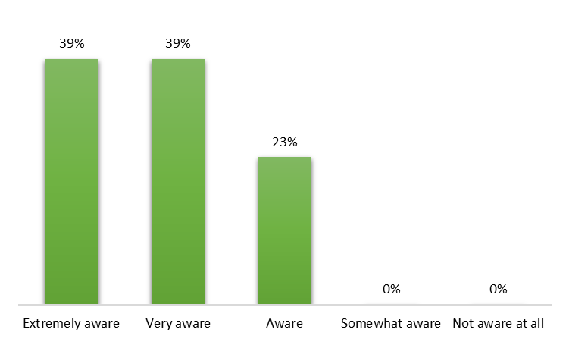
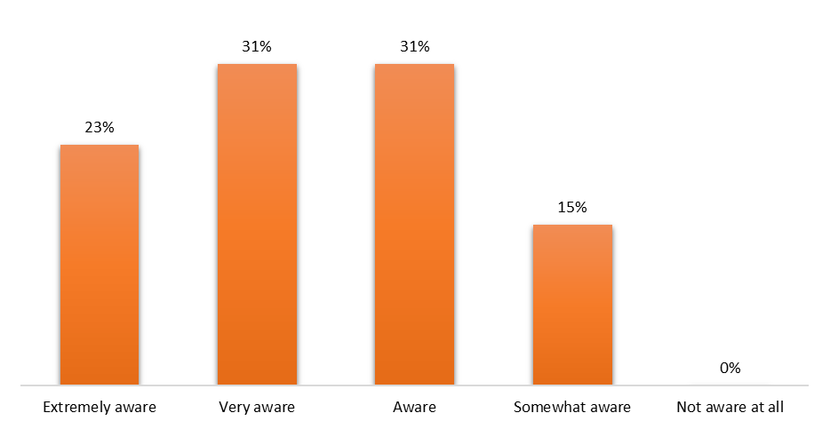
Awareness …
… of Cornwall’s Cultural Offer
… of Cornwall’s Event Programme

Slide 34
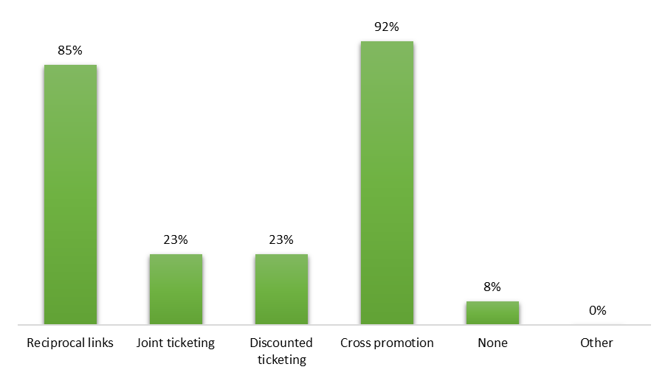
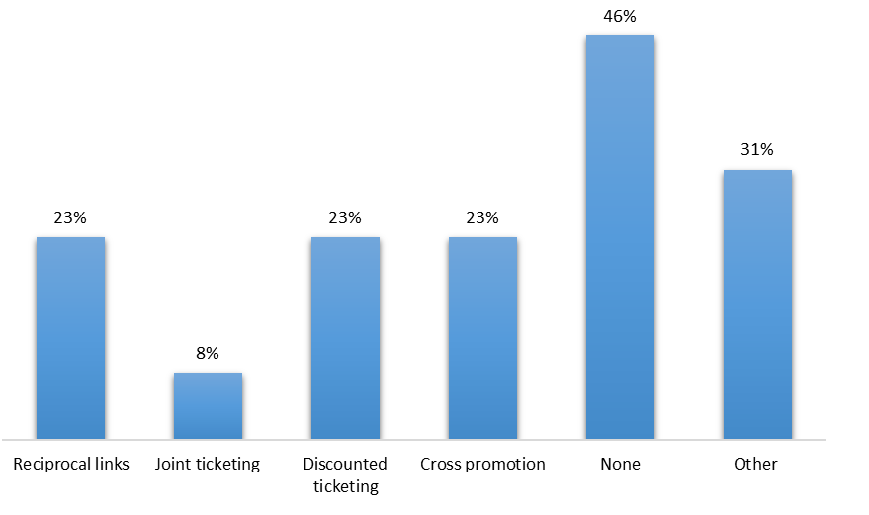
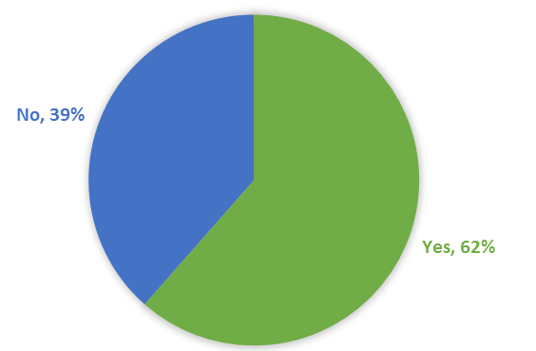
Collaboration Initiatives
With other cultural or tourism organisations
With communities within Cornwall
Cross promotion and reciprocal links are the two most common collaboration initiatives used with other organisations
62% say that they offer discounts / special offers to local residents

Slide 35
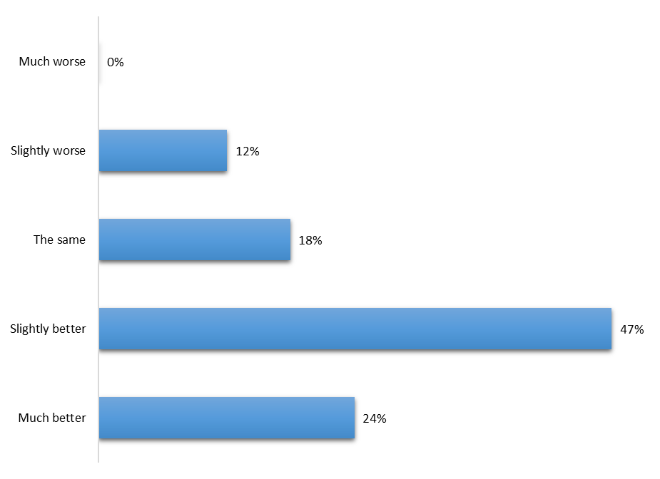
How does Cornwall’s wider cultural offer compare to other destinations?
Why is it particularly bad?
“Lack of quality venues, especially for music and theatre. From a literary point of view, we have no real publishing industry and no literary agencies.”
“The emphasis on the past has been on food and beaches”
Why is it particularly good?
“It is diverse, and innovative”
“We have such a diverse offering with a great deal of talent, products and experiences on offer”
“Embedded in a strong, long standing place of culture and uniqueness”

Slide 36
Recommend a CULTURAL EVENT to a TOURIST
Wild Works Wolf's Child, in the woods, next summer. Because it's awesome!
Golowan Festival in June. Because it is a unique and unforgettable community event
Du Maurier Festival has to be a highlight but is one among many. Always tell visiting friends to try to See Miracle or Kneehigh performance. Depending on tastes of visitors I usually suggest Penlee House or Tate for visual arts
Oyster Festival because it is quintessentially about Falmouth
I usually send visitors to St Ives on the train from St Erth as there is so much choice of things to do in St Ives! My other favourite place would be Falmouth and a trip to Pendennis Castle and the Maritime Museum
Fal River Festival - a broad range of cultural events celebrating Cornish Culture at its best - covering a wider area and not focused on a single location
Port Elliot, but this is based on its quirkiness and established brand

Slide 37
Recommend a CULTURAL ATTRACTION to a TOURIST
Telegraph Museum, Porthcurno. Unique heritage in unique context with truly GLOBAL stories
Museums generally but specifically the Royal Cornwall Museum as an introduction to Cornish heritage underpinned by the internationally significant diverse and rich collections.
Penlee House Gallery & Museum in Penzance - where else could you see some of the finest 19th century paintings of Cornwall by the world-renowned Newlyn School of artists?
Minack Theatre. One of a kind.
National Maritime Museum Cornwall because it is the most popular museum in Cornwall, has been recognised regionally as best in class and nationally as recognised as the most family friendly museum in the UK. Moreover, the museum has built a reputation for bringing exhibitions of international standing to the region.
Wheal Martyn - showcasing the heritage of an industry which shaped the landscape, lives and economy of Cornwall
Porthcurno Telegraph Museum because its unique

Slide 38
Recommend a SOMETHING CULTURAL to a TOURIST
The Merry Maidens stone circle at St Buryan - or any similar Bronze Age site in West Penwith. Because it is an awe-inspiring and evocative place
The whole of Cornwall- the landscape, but especially Bodmin Moor.
A 4,000 year old bronze age gold collar found in a burial site representing the rich Cornish Bronze Age heritage.
Surfing - great waves.
Penlee's - let it raineth painting
Find a local festival day. i.e. Obby Oss, Mazey Day, Golawen
Driving the coast road from St Ives to Lands End is something I always recommend as it passes so much beautiful coastal scenery and the world heritage mining landscapes.
Wheal Coates
Viking Voyagers at the National Maritime Museum Cornwall

