Slide 1







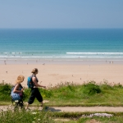
Cornwall Visitor Survey 2016/17
Full Year Final Report
(August 2016 – July 2017)
Produced for and on behalf of Visit Cornwall
By
The South West Research Company Ltd.
September 2017

Slide 2
Contents
Page
Key Findings 3
Introduction 4
Visitor Profile 13
Staying Visits 20
Characteristics of Visits 32
Train Travellers 43
Information Sourcing 52
Activities/Attractions & Places of Interest Visited 60
Visitors’ Opinions of Cornwall 66

Slide 3
Key Findings
This year 84% of visitors rated the overall enjoyment of their visit to Cornwall as very good and a further 13% said it was good.
The visit exceeded expectations for 27% of visitors.
Visitor satisfaction levels with their visit were high and the county achieved a recommendation score of +73% - an exceedingly high score on a metric that can range from -100% to +100%.
84% of visitors said they are likely to visit Cornwall again.
This year has seen the largest growth in the youngest (16-24 years) and oldest (65+ years) age groups visiting the county compared with last year.
At 27%, 2016/17 has seen the highest proportion of adults visiting the county with children for the five year trend period since 2012/13.
2016/17 has seen a year on year increase in secondary/additional holiday taking and the highest proportion across the analysis years.
Visit Cornwall remains the primary online information source for visitors whilst they are on holiday.

Slide 4
Cornwall Visitor Survey 2016/17
Introduction

Slide 5
Background
Cornwall has been consistently voted one of Britain’s top tourist destinations and in 2014 attracted approximately 4.5m staying visitors and 14m day visitors generating £2.8bn of business turnover in the county economy and supporting 55,000 jobs. Visit Cornwall, which is the tourist board for Cornwall, is committed to building on this success and seizing every opportunity to continue to make Cornwall a quality destination of choice. It is recognised that Cornwall’s economy will always have a strong tourism element (as part of a balanced Cornish economy) and the continuing challenge is to increase the contribution tourism makes.
A key priority for Visit Cornwall is to identify the needs of visitors to Cornwall to ensure continuous improvement of the visitor experience and, as such, they have carried out a visitor survey for over 17 years for this purpose. The Cornwall Visitor survey looks at a range of visitor information including profile, motivation, level of satisfaction etc. and is a valuable piece of work which steers their marketing strategy, makes recommendations for product development and identifies emerging trends.
This full year report for 2016/17 contains the key findings for the survey based on a total sample of 1,123 face to face interviews conducted between August 2016 and July 2017 at a number of key sample points across the county agreed in full consultation with Visit Cornwall (see table overleaf for details of sample points).
The survey has been designed to keep in line with previous years but changes have also been made to reflect the current needs of the industry. Comparisons with the results from previous survey years have also been included in this report where meaningful to do so. Further breakdowns of the results by period, area, location and visitor type have also been provided where appropriate but please refer to the margins of error associated with each of these sub-samples on page 9 of this report when interpreting the results. This report has been produced by the South West Research Company (TSWRC) on behalf of Visit Cornwall.

Slide 6
Research aims & objectives
The specific objectives of the 2015/16 research were :
  To provide up-to-date information on the origin, profile and behaviour of visitors to Cornwall and to explore the nature of their trips made to the county between August 2016 and July 2017.
  To ascertain detailed information about internet usage amongst visitors to the resort.
  To identify visitors’ motivations to visit Cornwall as well as the quality of their visitor experience whilst on holiday in the resort i.e. visitor satisfaction.
  To establish visitors’ information requirements before and during their holiday.
  To compare directly with the results from the 2012/13, 2013/14, 2014/15 & 2015/16 surveys and identify any key trends in relation to all of the above and, where possible, to identify any emerging trends so that more informed decisions can be made in relation to marketing initiatives and facility provision, as well as strategic planning.

Slide 7
Sample points
The following sample points were agreed in full consultation with Visit Cornwall:
Sample point | Sample area | Location type | Sample point | Sample area | Location type
Bodmin | Bodmin/Tamar Valley | Urban | Marazion | West | Coastal
Bude | North | Coastal | Mevagissey | South | Coastal
Charlestown | South | Coastal | Minions | Bodmin/Tamar Valley | Rural
Falmouth | South | Coastal | Newquay | North | Coastal
Fowey | South | Coastal | Padstow | North | Coastal
Helston | West | Urban | Penzance | West | Urban
Launceston | Bodmin/Tamar Valley | Rural | Perranporth | North | Coastal
Liskeard | Bodmin/Tamar Valley | Rural | St Ives | West | Coastal
The Lizard | West | Rural | Truro | South | Urban
Looe | South | Coastal | Wadebridge | North | Rural

Slide 8
Methodology
A face to face survey was conducted by a team of experienced fieldwork interviewers over the course of the survey year between August 2016 and July 2017. Adults aged 16+ were interviewed on a random basis and to ensure only ‘visitors’ to the county were interviewed filter questions were used to exclude residents of Cornwall and those on day visits concerned with their normal work or regular/household shopping. A total of 1,123 interviews were achieved in total and for the purposes of data collection and analysis, and to ensure that the survey was reflective of the flow of visitors to the county throughout the different months of the year, it was divided into three periods as follows:
The sample points were split between four sample areas and three types of sample locations as follows:

Slide 9
Statistical reliability
All sample surveys are subject to statistical error. The size of this error varies with the sample size and also with the order of magnitude of the research findings being considered.
The survey results in this report are presented for all visitors and separately for period of interview, area and location of interview and for day and staying visitors. The table below shows the sample achieved for all visitors and for each of the sub-samples and gives the margins within which one can be 95% certain that the true figures will fall (assuming the sample is random). Please note that the analysis breakdowns below are only included in the report to follow where it is meaningful to do so and where value is added to the report findings and interpretation of the results by doing so.
The figures shown are at the 95% confidence limits. Thus, for example, we can be 95% certain that, for all visitors, with a result of 50%, the true percentage is the range 47.1% to 52.9%. For day visitors, where the sample is much smaller, the range is much wider as a result – 40.2% to 59.8%. These margins of error shown below should be borne in mind when interpreting the results contained in this report and particularly where the results have been included for day visitors.
Research findings | All visitors 2016/17 | Summer | Autumn/Winter | Spring | West Cornwall | North Coast | South Coast | Bodmin/ Tamar Valley | Coastal | Urban | Rural | Day | Staying
Sample size: | 1,123 | 499 | 369 | 255 | 273 | 325 | 296 | 229 | 660 | 218 | 245 | 99 | 1,020
10% or 90% | +/- 1.8 | +/- 2.6 | +/- 3.1 | +/- 3.7 | +/- 3.6 | +/- 3.3 | +/- 3.4 | +/- 3.9 | +/- 2.3 | +/- 4.0 | +/- 3.8 | +/- 5.9 | +/- 1.8
20% or 80% | +/- 2.3 | +/- 3.5 | +/- 4.1 | +/- 4.9 | +/- 4.7 | +/- 4.3 | +/- 4.6 | +/- 5.2 | +/- 3.1 | +/- 5.3 | +/- 5.0 | +/- 7.9 | +/- 2.5
30% or 70% | +/- 2.7 | +/- 4.0 | +/- 4.7 | +/- 5.6 | +/- 5.4 | +/- 5.0 | +/- 5.2 | +/- 5.9 | +/- 3.5 | +/- 6.1 | +/- 5.7 | +/- 9.0 | +/- 2.8
40% or 60% | +/- 2.9 | +/- 4.3 | +/- 5.0 | +/- 6.0 | +/- 5.8 | +/- 5.3 | +/- 5.6 | +/- 6.3 | +/- 3.7 | +/- 6.5 | +/- 6.1 | +/- 9.7 | +/- 3.0
50% | +/- 2.9 | +/- 4.4 | +/-5.1 | +/- 6.1 | +/- 5.9 | +/- 5.4 | +/- 5.7 | +/- 6.5 | +/- 3.8 | +/- 6.6 | +/- 6.3 | +/- 9.8 | +/- 3.1

Slide 10
The Tourism Year
In 2016, British residents took 99.3 million overnight trips in England, totalling 288 million nights away from home, with an average trip length of 2.90 nights. The number of domestic trips was 3% lower than in 2015.
44.7 million holiday trips were taken in England in 2016. The number of holiday trips taken was 2% higher than in 2015. At 29.3 million, short breaks of 1-3 nights account for two-thirds of English holidays by volume. 15.4 million 4+ night holidays were taken.
14.1 million overnight business trips were taken in England in 2016. The number of business trips rose by 2% year-on-year.
The number of VFR trips taken declined by 9% in 2016, to 36.9 million.
Holiday VFR saw growth in 2016 whilst so-called “duty” VFR decreased, with volumes increasing by 2% and decreasing by 24% respectively.

Slide 11
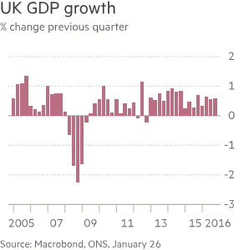
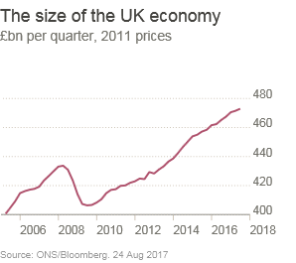
The UK Economy
Economic growth held up better than expected in the second half of 2016 but has slowed in 2017. Forecasters predict that rising inflation, driven by the depreciation of sterling, will squeeze household incomes and depress consumer spending, which has been the main driver of economic growth in recent years.
The British economy turned in a steady performance in 2016, growing at the second fastest rate among the G7 economies. Growth in the sixth months following the EU referendum was significantly stronger than some had feared pre-vote, when the Treasury and others predicted a Brexit vote would result in recession.
Growth in 2016 was stronger than the OBR and other forecasters were expecting at the start of the year, with little sign of any immediate post-Brexit slowdown. But the OBR predicts growth will slow in 2017 and 2018 as businesses delay investment plans and household incomes start to be squeezed by rising inflation. The vast majority of economists expect the decision to leave the EU to hit growth in the medium to longer term.

Slide 12
The UK Weather
The majority of months were at least slightly warmer than average for the UK as a whole, most notably September and December whose anomalies were around +2 °C. However, both April and November were around a degree cooler than average. Most places were within 10% of the yearly average for rainfall with a slight tendency for eastern areas to be wetter and western areas drier. Sunshine was slightly above average generally
The most extreme weather events of the year were a series of five named winter storms (Gertrude, Henry, Imogen, Jake and Katie) which occurred between late January and late March, bringing some damaging winds. Storm Angus in mid-November and Barbara and Conor over the Christmas period also caused some disruption.
The best of the summer weather was experienced in late July, late August and early September with two or three notable but short-lived heat-waves (34.4 °C was recorded at Gravesend, Kent, on 13 September, an unusually late date for the year’s highest temperature), but there were also some instances of thundery summer downpours causing localised flash-flooding and including two notable cases of widespread disruption to electricity grid supplies due to lightning.
2016 was a somewhat sunnier than average year for many areas but again no individual regions deviated by as much as 10% above the long-term average. January was a dull month whereas Northern Scotland was particularly sunny, relative to average, in October and November.

Slide 13
Cornwall Visitor Survey 2016/17
Visitor Profile

Slide 14
Visitor type remains similar to previous years
.
Overall, there were no significant changes to the type of visitors visiting the county in 2016/17 with 91% staying in Cornwall, 5% visiting for the day from home and 4% visiting from the day from a holiday base outside of Cornwall.
Looking at the analysis segments day visitors are less likely in Autumn/Winter and in West Cornwall and on the South Coast and to visit urban areas.
Are you….? | Period |  |  |  | Area |  |  |  | Location
 | 2016/17 | Summer | Autumn/Winter | Spring | West Cornwall | North Coast | South Coast | Bodmin/ Tamar Valley | Coastal | Urban | Rural
On a day trip from home | 5% | 6% | 3% | 6% | 1% | 7% | 3% | 10% | 5% | 2% | 9%
Staying overnight in Cornwall | 91% | 86% | 97% | 92% | 99% | 90% | 96% | 77% | 94% | 94% | 81%
Staying overnight outside of Cornwall | 4% | 7% | - | 2% | - | 3% | 1% | 12% | 2% | 3% | 10%

Slide 15
Summer/Spring and Autumn/Winter are two distinct periods
The age profiles of visitors were broadly similar for Summer and Spring with around a third of visitors over 55 years old and a further third aged between 35 and 44 years of age. Approximately one fifth of visitors in these periods were children.
In contrast, half of visitors in the Autumn/Winter were over 55, 23% aged between 35 and 44 years of age and just 12% were children.
Visitors aged between 16 and 35 years of age were relatively consistent across all periods and ranging from 12% to 17%.
.

Slide 16
Growth in youngest and oldest adult visitors in 2016/17
The key changes in age profile compared to 2015/16 were a 5% increase in visitors aged 65 years or more (24% in 2016/17 and 19% in 2015/16) and a 5% increase in visitors aged 16 to 24 years of age (8% in 2016/16 and 3% in 2015/16).
The proportion of visitors aged 65 years or more returned to similar levels as in 2014/15 and the proportion of visitors aged 16 to 24 years is the second highest recorded across the trend period and only lower than the 15% recorded in 2013/14.
The proportions of other age groups in 2016/17 was largely similar to the previous year.
.

Slide 17
A further increase in groups visiting the county with children
The proportion of adults with children groups increased again in 2016/17 to 27%. This is the highest proportion for the five year trend period.
It’s unclear as to the exact reason for this further increase in groups with children and it may be an area that requires further research. The UK law regards holiday taking during term time remains unchanged and a high profile court battle was recently lost by a parent in the supreme court, however, there are suggestions that some councils are relaxing their approach to the law. Perhaps it may just be that the law has resulted in more families grabbing the opportunity to holiday in the end of term and half term periods?
Group composition. | Period |  |  |  | Area |  |  |  | Location |  |  | Visitor type
 | 2016/17 | Summer | Autumn/winter | Spring | West Cornwall | North Coast | South Coast | Bodmin/ Tamar Valley | Coastal | Urban | Rural | Day | Staying
Adults only | 73% | 69% | 84% | 65% | 79% | 68% | 78% | 68% | 75% | 83% | 60% | 79% | 73%
Adults with children | 27% | 31% | 16% | 35% | 21% | 32% | 22% | 32% | 25% | 17% | 40% | 21% | 27%
Ave. children | 0.51 | 0.58 | 0.32 | 0.66 | 0.41 | 0.63 | 0.43 | 0.57 | 0.49 | 0.31 | 0.77 | 0.41 | 0.52
Ave. adults | 2.38 | 2.33 | 2.33 | 2.56 | 2.33 | 2.44 | 2.48 | 2.24 | 2.47 | 2.23 | 2.29 | 2.31 | 2.39
Ave. group size | 2.90 | 2.92 | 2.65 | 3.22 | 2.74 | 3.07 | 2.92 | 2.82 | 2.96 | 2.54 | 3.06 | 2.73 | 2.91

Slide 18
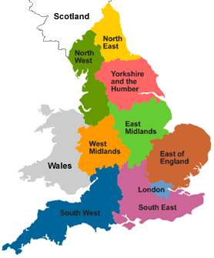
Visitor origin remains similar to previous years
Overall the origins of visitors to the county in 2016/17 was similar to previous years.
When looking at the analysis segments fewer overseas visitors visit in the Autumn/Winter than in Summer/Spring and are more likely in rural locations, South West residents favour West and North Cornwall and are more likely to be day visitors.
Visitor origin | Period |  |  |  | Area |  |  |  | Location |  |  | Visitor type
 | 2016/17 | Summer | Autumn/Winter | Spring | West Cornwall | North Coast | South Coast | Bodmin/ Tamar Valley | Coastal | Urban | Rural | Day | Staying
South West/local resident | 27% | 23% | 30% | 28% | 30% | 30% | 21% | 26% | 28% | 25% | 23% | 59% | 24%
Other UK resident | 68% | 69% | 68% | 67% | 64% | 68% | 77% | 62% | 69% | 70% | 66% | 31% | 72%
Overseas resident | 5% | 7% | 2% | 5% | 6% | 2% | 2% | 12% | 3% | 5% | 12% | 10% | 5%

Slide 19
Socio economic group C1 provided 44% of visitors
Visitors were either employed (71%) or retired (28%). The large majority of those that were retired had a company/private pension.
The largest proportion of visitors were classified in group C1 as has been the case in all but two of the previous years (2012/13 & 2013/14). The proportion of C1s was similar to 2015/16.
The proportion of visitors classified as ABs (23%) was the lowest across all survey years.
Socio-economic classifications
A - Approximately 3% of the total population.
These are professional people, very senior managers
B - Approximately 20% of the total population
Middle management executives in large organisations, principal officers in local government, top management or owners of small business concerns.
C1 - Approximately 28% of the total population.
Junior management, owners of small establishments and all others in non-manual positions.
C2 - Approximately 21% of the total population.
All skilled manual workers and those manual workers with responsibility for other people.
D - Approximately 18% of the total population.
All semi-skilled and un-skilled manual workers, apprentices and trainees to skilled workers.
E - Approximately 10% of the total population.
All those entirely dependent on the state long-term, through sickness, unemployment, old age or other reasons. Those unemployed for a period exceeding six months

Slide 20
Cornwall Visitor Survey 2016/17
Staying Visits

Slide 21
Self catering remains the most popular accommodation type
As in previous years self catering accommodation was used by the largest proportion of respondents (39%) and by a similar proportion as in previous years.
Overall the accommodation used was similar to previous years across all types. Camping increased in the Summer and serviced accommodation usage increased in the Autumn/Winter.
Average length of stay during 2016/17 was 6.39 nights.
There was no comparable data available for the 2012/13 research.
What type of accommodation are you staying in during your visit to Cornwall? | Period |  |  |  | Area |  |  |  | Location
 | 2016/17 | Summer | Autumn/Winter | Spring | West Cornwall | North Coast | South Coast | Bodmin/ Tamar Valley | Coastal | Urban | Rural
Self catering | 39% | 37% | 36% | 49% | 47% | 32% | 40% | 38% | 38% | 36% | 47%
Serviced accommodation (Hotel/B&B/Guest house) | 24% | 19% | 35% | 18% | 27% | 29% | 23% | 15% | 29% | 25% | 9%
Camping/own caravan | 13% | 21% | 7% | 6% | 6% | 15% | 13% | 19% | 11% | 15% | 15%
Other | 12% | 11% | 12% | 12% | 12% | 8% | 12% | 18% | 9% | 14% | 19%
Static caravan/holiday park | 8% | 9% | 6% | 10% | 5% | 13% | 7% | 7% | 9% | 7% | 9%
Own second home | 3% | 2% | 3% | 5% | 2% | 4% | 4% | 2% | 4% | 3% | 2%
Ave. length of stay (nights) | 6.39 | 7.92 | 5.77 | 6.74 | 6.58 | 6.62 | 7.07 | 7.81 | 6.61 | 7.06 | 7.81

Slide 22
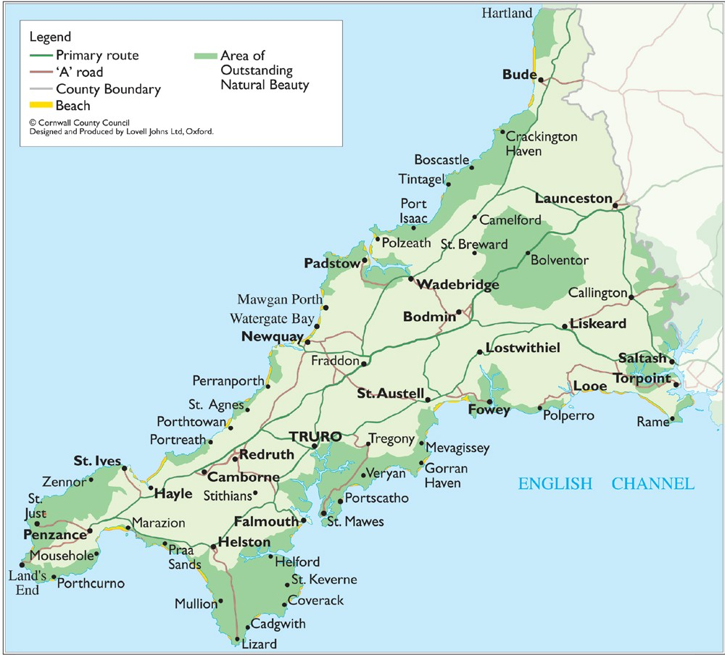
Newquay is a key attraction for visitors
Where are you staying in Cornwall - top locations where staying (>1%)
NEWQUAY | 10.85% | HAYLE | 1.72%
ST IVES | 6.29% | HELSTON | 1.52%
PADSTOW | 5.58% | LISKEARD | 1.52%
FALMOUTH | 5.27% | MARAZION | 1.42%
LOOE | 4.36% | CARBIS BAY | 1.32%
PENZANCE | 4.06% | PORTHLEVEN | 1.32%
PERRANPORTH | 2.74% | MEVAGISSEY | 1.22%
BODMIN | 2.54% | PORT ISSAC | 1.22%
BUDE | 2.54% | ST MAWES | 1.22%
ST AUSTELL | 2.33% | LAUNCESTON | 1.12%
TRURO | 2.03% | WADEBRIDGE | 1.01%
FOWEY | 1.72%
Approximately 11% of staying visitors were staying in Newquay, almost double that of the next largest location (St Ives 6%).
The top six locations accounted for approximately 36% of staying visitors; Newquay, St Ives, Padstow, Falmouth, Looe and Penzance.
The top three locations are all located on the North coast of Cornwall.

Slide 23
The majority of staying visitors opted for small coastal locations
Small coastal towns and villages were chosen by the largest proportion of staying visitors across all periods, areas and locations.
In most cases the next largest proportion of visitors were staying in large coastal towns or resorts with the following exceptions in the analysis segments where non-coastal countryside and villages were larger; Summer (24%), Bodmin/Tamar Valley (38%) and Rural (32%).
Which of the following best describes the type of area you are staying in? | Period |  |  |  | Area |  |  |  | Location
 | 2016/17 | Summer | Autumn/Winter | Spring | West Cornwall | North Coast | South Coast | Bodmin/ Tamar Valley | Coastal | Urban | Rural
Small coastal town/village | 54% | 51% | 51% | 64% | 59% | 54% | 57% | 42% | 59% | 44% | 49%
Large coastal town/resort | 21% | 17% | 30% | 15% | 23% | 27% | 22% | 7% | 24% | 26% | 7%
Countryside/village (non-coastal) | 18% | 24% | 13% | 14% | 13% | 14% | 14% | 38% | 13% | 20% | 32%
Large city/town (non-coastal) | 7% | 8% | 6% | 7% | 6% | 4% | 7% | 13% | 5% | 10% | 12%
There was no comparable data available for previous years.

Slide 24
2016/17 saw an increase in secondary/additional holidays
51% of staying visitors classed their trip to Cornwall as a secondary/additional holiday and increase of 9% on 2015/16 and the highest proportion across the analysis years.
The growth in additional holidays was at the expense of short breaks which decreased from 31% in 2015/16 to 23% in 2016/17 and to the lowest level of all analysis years. However, it could be expected that this could result in an overall growth in visitor nights spent in the county.
Main holidays increased slightly to 25% of staying visits.
Would you describe this trip as your….? | Period |  |  |  | Area |  |  |  | Location
 | 2016/17 | Summer | Autumn/Winter | Spring | West Cornwall | North Coast | South Coast | Bodmin/ Tamar Valley | Coastal | Urban | Rural
Main holiday of year | 25% | 39% | 15% | 13% | 17% | 24% | 21% | 44% | 21% | 19% | 43%
Secondary/additional holiday | 51% | 42% | 56% | 61% | 70% | 42% | 55% | 33% | 51% | 63% | 40%
A short break | 23% | 17% | 29% | 25% | 13% | 33% | 24% | 20% | 28% | 18% | 15%
Other | 1% | 1% | 1% | - | - | 1% | 0% | 3% | 0% | 0% | 2%

Slide 25
9% of staying visits were instead of a trip overseas
The proportion of staying visits that were made to Cornwall instead of a holiday abroad decreased to 9% from 13% in 2015/16.
This, coupled with the increase in additional/secondary holidays examined on the previous page possibly suggests an increase in holiday taking generally amongst visitors to Cornwall.
Does this trip to Cornwall replace a holiday that would normally be taken abroad? | Period |  |  |  | Area |  |  |  | Location
 | 2016/17 | Summer | Autumn/Winter | Spring | West Cornwall | North Coast | South Coast | Bodmin/ Tamar Valley | Coastal | Urban | Rural
Yes | 9% | 12% | 7% | 5% | 5% | 12% | 5% | 15% | 8% | 5% | 15%
No | 90% | 86% | 92% | 95% | 95% | 86% | 94% | 83% | 91% | 95% | 83%
Don't know | 1% | 1% | 1% | 0% | - | 2% | 0% | 2% | 1% | - | 2%

Slide 26
For the large majority of visitors Cornwall is the only choice
Just 9% of visitors overall considered an alternative destination before choosing to visit Cornwall, with this percentage rising to 14% during the peak summer season when the county is at its most vulnerable to competitors.
Around three quarters of those considering alternative destinations were looking at other UK destinations.
Did you consider visiting any other places before deciding to visit Cornwall? | Period | Area |  |  |  | Location
 | 2016/17 | West Cornwall | North Coast | South Coast | Bodmin/ Tamar Valley | Coastal | Urban | Rural
Yes | 9% | 2% | 10% | 6% | 22% | 7% | 7% | 19%
No | 91% | 98% | 90% | 94% | 78% | 93% | 93% | 81%
There was no comparable data available for previous years.

Slide 27
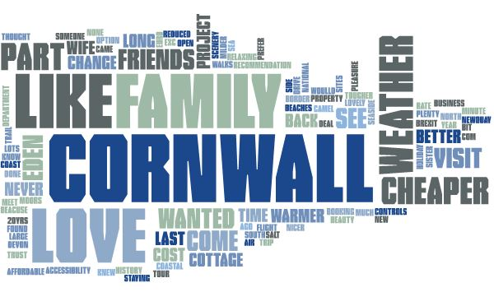
Familiarity with the county was a key driver for decisions
Visitors that had considered alternative destinations were asked why they had finally decided on Cornwall and the key themes are displayed in the word cloud below. Previous visits to Cornwall, including visits to friends and family in the county play a large part in making the final decision to visit for those also considering other destinations for their holiday.

Slide 28
Familiarity with the county was a key driver for decisions
Visitors that had considered alternative destinations were asked why they had finally decided on Cornwall and a selection of responses are shown below;
BEEN BEFORE / KNOW IT
CHEAPER
FAMILY / FRIENDS HERE
GOOD / MILDER WEATHER
LIKE IT / LOVE CORNWALL
NOT VISITED FOR A WHILE
SEA / SEASIDE
NEVER VISITED BEFORE
PART OF TOUR / ORGANISED TRIP

Slide 29
The large majority explore the county during their visit
83% of visitors travelled around the county away from their accommodation during their visit with this most likely to happen during Summer and Spring rather than Winter and least likely to happen amongst those at coastal locations.
91% of those travelling around the county used a car/van.
How will you travel around Cornwall?
Will you travel around Cornwall away from the local area where your accommodation is based during your stay? | Period | Area |  |  |  | Location
 | 2016/17 | West Cornwall | North Coast | South Coast | Bodmin/ Tamar Valley | Coastal | Urban | Rural
Yes | 83% | 76% | 81% | 86% | 93% | 79% | 88% | 92%
No | 17% | 24% | 19% | 14% | 7% | 21% | 12% | 8%
There was no comparable data available for previous years.

Slide 30
There is a willingness to travel across the county during a visit
Of those that travelled around the county just 5% would not consider a journey of longer than 30 minutes.
36% in each case would consider a journey time of up to an hour or up to an hour and a half and 23% would consider a journey in excess of an hour and a half.
This clearly demonstrates the potential for businesses across Cornwall to market in the key areas for staying visitors regardless of where their business is based in the county.
What is the longest journey length you will consider travelling to get to a place of interest in Cornwall? | Period | Area |  |  |  | Location
 | 2016/17 | West Cornwall | North Coast | South Coast | Bodmin/ Tamar Valley | Coastal | Urban | Rural
30 mins or less | 5% | 5% | 9% | 4% | 1% | 6% | 4% | 3%
31-60 mins | 36% | 39% | 37% | 39% | 28% | 39% | 38% | 27%
60-90 mins | 36% | 38% | 38% | 32% | 36% | 33% | 33% | 45%
> 90 mins | 23% | 18% | 16% | 25% | 34% | 21% | 26% | 25%
There was no comparable data available for previous years.

Slide 31
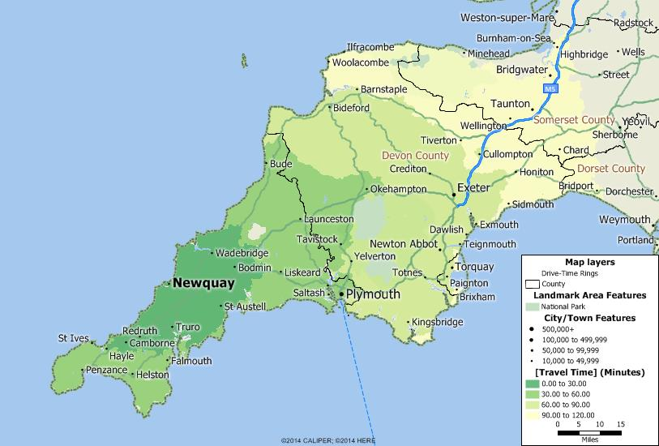
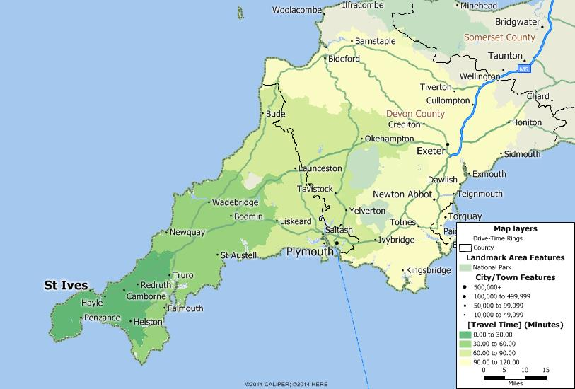
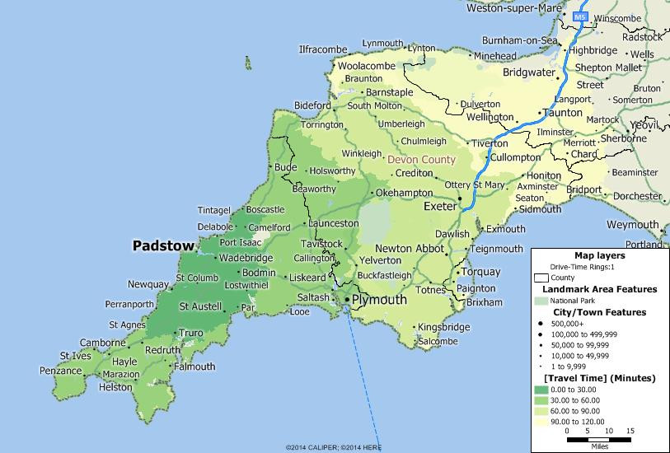
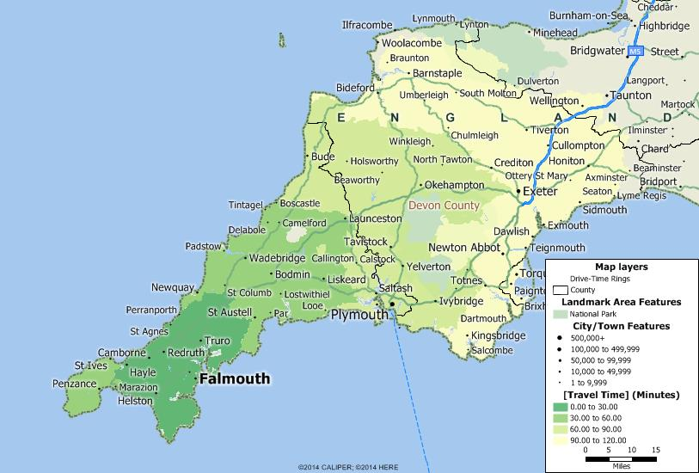
The catchment areas from the key staying destinations are large
The drive time bands from each of the main locations of staying visitors in the county are shown below and clearly demonstrate the large areas covered by staying visitors travelling out from these destinations during their stay.

Slide 32
Cornwall Visitor Survey 2016/17
Characteristics of Visits

Slide 33
Unsurprisingly leisure trips dominate visits to the county
Just 2% of visitors to the county were on a business trip.
Bodmin/Tamar Valley and Rural areas saw the largest proportions of business trips with business visitors more likely to be day visitors.
The small sample sizes associated with business trips should be considered when interpreting this data.
Would you consider yourself to be visiting Cornwall for leisure or business purposes on this occasion? | Period |  |  |  | Area |  |  |  | Location |  |  | Visitor type
 | 2016/17 | Summer | Autumn/Winter | Spring | West Cornwall | North Coast | South Coast | Bodmin/ Tamar Valley | Coastal | Urban | Rural | Day | Staying
Leisure trip | 98% | 97% | 99% | 100% | 99% | 99% | 99% | 95% | 99% | 98% | 96% | 93% | 99%
Business trip | 2% | 3% | 1% | - | 1% | 1% | 1% | 5% | 1% | 2% | 4% | 7% | 1%
There was no comparable data available for previous years.

Slide 34
First time visitors decreased slightly in 2016/17
.
Whilst the proportion of first time visitors decreased slightly to 11% in 2016/17 it is still a broadly similar proportion to those recorded in 2015/16, 2013/14 and 2012/13.
This suggests that whilst Cornwall is not increasing the numbers of new visitors it is successfully continuing to attract a similar level of new visitors and subsequently new visitor spend each year.
Is this your first ever visit to Cornwall? | Period |  |  |  | Area |  |  |  | Location |  |  | Visitor type
 | 2016/17 | Summer | Autumn/Winter | Spring | West Cornwall | North Coast | South Coast | Bodmin/ Tamar Valley | Coastal | Urban | Rural | Day | Staying
Yes | 11% | 14% | 7% | 11% | 15% | 5% | 12% | 13% | 8% | 19% | 11% | 6% | 11%
No | 89% | 86% | 93% | 89% | 85% | 95% | 88% | 87% | 92% | 81% | 89% | 94% | 89%

Slide 35
Previous visitors are loyal visitors
.
The proportion of previous visitors within the last 12 months decreased to 45% in 2016/17 compared to 54% in 2015/16. However, when coupled with those respondents visiting 1-2 years ago the combined proportion of previous visitors within the last two years remains similar at approximately three quarters of visitors. In research terms these would be considered as current visitors.
A quarter of previous visitors were lapsed visitors returning to the county after a period of 3 years or more.
When was your LAST visit to Cornwall? | Period |  |  |  | Area |  |  |  | Location |  |  | Visitor type
 | 2016/17 | Summer | Autumn/Winter | Spring | West Cornwall | North Coast | South Coast | Bodmin/ Tamar Valley | Coastal | Urban | Rural | Day | Staying
Within the last 12 months | 45% | 38% | 51% | 50% | 40% | 52% | 46% | 41% | 49% | 37% | 41% | 60% | 44%
1-2 years ago | 29% | 34% | 25% | 28% | 39% | 28% | 24% | 28% | 27% | 34% | 33% | 22% | 30%
3 or more years ago | 25% | 29% | 24% | 22% | 22% | 20% | 31% | 32% | 24% | 29% | 26% | 18% | 26%

Slide 36
Whilst visitors are loyal there is flexibility in when they visit
38% of visitors stated that they tended to visit Cornwall at the same time each year with Summer visitors (41%) slightly more likely to do so than those visiting in Autumn/Winter or Spring (36% in each case).
Visitors to West Cornwall (27%), Urban locations (23%) and Day Visitors (25%) were less likely to visit at the same time each year.
This possibly suggests there is potential to attract current visitors at different times across the year.
Do you tend to visit Cornwall during the same time each year? - Previous visitors last 12 months | Period |  |  |  | Area |  |  |  | Location |  |  | Visitor type
 | 2016/17 | Summer | Autumn/Winter | Spring | West Cornwall | North Coast | South Coast | Bodmin/ Tamar Valley | Coastal | Urban | Rural | Day | Staying
Yes | 38% | 41% | 36% | 36% | 27% | 45% | 36% | 37% | 40% | 23% | 38% | 25% | 39%
No | 62% | 59% | 64% | 64% | 73% | 55% | 64% | 63% | 60% | 77% | 62% | 75% | 61%
There was no comparable data available for previous years.

Slide 37
Same time return visitors reflect expected seasonality
Those visitors that tended to visit at the same time each year were asked in which months they visited. As demonstrated in the chart and in the table below their months of visit are likely to be a good match to what would be expected for seasonality of visits to the county generally.
During which months of the year do you usually visit Cornwall? – Previous visitors in last 12 months who tend to visit the same time each year | Period |  |  |  | Area |  |  |  | Location |  |  | Visitor type
 | 2016/17 | Summer | Autumn/Winter | Spring | West Cornwall | North Coast | South Coast | Bodmin/ Tamar Valley | Coastal | Urban | Rural | Day | Staying
Jan | 3% | 3% | 3% | 3% | 4% | 3% | 5% | - | 3% | - | 3% | - | 3%
Feb | 5% | 6% | 8% | - | 4% | 7% | 3% | 7% | 6% | 7% | 3% | - | 5%
Mar | 10% | 9% | 8% | 15% | - | 19% | 8% | - | 14% | - | 3% | 7% | 11%
Apr | 18% | 14% | 6% | 43% | 4% | 22% | 28% | 7% | 21% | 7% | 12% | 36% | 17%
May | 17% | 13% | 10% | 38% | 4% | 21% | 15% | 23% | 16% | 7% | 26% | 29% | 17%
June | 24% | 27% | 19% | 28% | 13% | 28% | 15% | 37% | 21% | 27% | 35% | 29% | 24%
Jul | 27% | 50% | 8% | 20% | 21% | 26% | 25% | 37% | 21% | 27% | 50% | 29% | 27%
Aug | 36% | 67% | 13% | 20% | 17% | 32% | 50% | 40% | 32% | 33% | 50% | 36% | 36%
Sept | 24% | 13% | 40% | 18% | 13% | 38% | 13% | 17% | 28% | 27% | 9% | 21% | 25%
Oct | 16% | 14% | 24% | 8% | 4% | 26% | 15% | 3% | 21% | 7% | 6% | 14% | 17%
Nov | 9% | 2% | 21% | 3% | 17% | 13% | 5% | - | 13% | - | - | - | 10%
Dec | 13% | 8% | 24% | 5% | 13% | 19% | 5% | 10% | 16% | 7% | 6% | - | 15%
All | 10% | 6% | 6% | 20% | - | 7% | 10% | 23% | 8% | - | 21% | 36% | 7%
Varies | 6% | 5% | 8% | 5% | 25% | 4% | 3% | - | 8% | 7% | - | 14% | 5%
There was no comparable data available for previous years.

Slide 38
On the whole Cornwall is considered better value for money than other UK destinations
The value for money of accommodation in the county was rated the highest when compared with other destinations at 4.14 out of 5.00. 78% of respondents rated this indicator as good or very good. This was followed closely by overall value for money (4.07) and the value for money when visiting attractions (4.00).
Lower scores were achieved for the value for money of eating out in restaurants (3.86) and pubs (3.90).
Ave. score
(out of max. 5.00)
4.07
4.00
3.86
3.90
4.14
There was no comparable data available for previous years.

Slide 39
Road transport accounts for more than 90% of visits
Their own car or van (82%) was the most popular form of transport used when visiting Cornwall with a further 6% using a hire car or van.
A further 4% of visitors also travelled by road either through an organised coach tour (3%) or a bus/coach service (1%).
There is little variation across the analysis segments although train usage is more likely in Urban locations and in West Cornwall.
What was the MAIN form of transport you used for the longest part of your journey to Cornwall today/this visit? | Period |  |  |  | Area |  |  |  | Location |  |  | Visitor type
 | 2016/17 | Summer | Autumn/Winter | Spring | West Cornwall | North Coast | South Coast | Bodmin/ Tamar Valley | Coastal | Urban | Rural | Day | Staying
Own car/van etc. | 82% | 84% | 76% | 88% | 74% | 85% | 84% | 87% | 83% | 76% | 86% | 82% | 82%
Hire car/van | 6% | 5% | 9% | 4% | 11% | 4% | 4% | 5% | 6% | 6% | 6% | 4% | 6%
Train | 4% | 4% | 5% | 2% | 8% | 2% | 4% | 3% | 4% | 8% | 2% | 2% | 4%
Organised coach tour | 3% | 1% | 6% | 1% | 3% | 4% | 4% | - | 3% | 5% | - | 1% | 3%
By plane/air travel | 2% | 3% | 2% | 2% | 3% | 2% | 1% | 3% | 2% | 3% | 2% | 3% | 2%
Bus/coach service | 1% | 1% | 1% | 2% | 0% | 2% | 1% | 2% | 1% | 1% | 2% | 6% | 1%
Other | 1% | 1% | - | - | 1% | 1% | 1% | - | 1% | - | 1% | 2% | -
Bicycle | - | - | 1% | - | - | 1% | - | - | - | - | - | - | -
Taxi | - | - | - | 1% | - | - | - | - | - | - | - | - | -
There was no comparable data available for previous years.

Slide 40
There is potential to increase train usage, although limited
14% of non-train users said they would be quite likely or very likely to consider using the train to get to Cornwall in the future.
Variations by period for those who would consider the train in the future are small and only evident for the Autumn/Winter period.
The largest likelihood of using the train in the future was in West Cornwall and is likely to be linked to the increased journey time by road to this area and the availability of a major station.
If you were coming to Cornwall again how likely would you be to consider using the train to get here? | Period | Area |  |  |  | Location |  |  | Visitor type
 | 2016/17 | West Cornwall | North Coast | South Coast | Bodmin/ Tamar Valley | Coastal | Urban | Rural | Day | Staying
Very likely | 2% | 4% | 1% | 4% | 1% | 3% | 3% | 2% | 2% | 2%
Quite likely | 12% | 19% | 10% | 12% | 8% | 14% | 14% | 8% | 9% | 13%
Unlikely | 29% | 40% | 27% | 29% | 21% | 32% | 30% | 22% | 20% | 30%
Very unlikely | 56% | 37% | 62% | 55% | 70% | 52% | 53% | 68% | 68% | 55%
There was no comparable data available for previous years.

Slide 41

Convenience, freedom, cost and luggage/equipment are major restrictions to using the train
Those not using the train were asked why not and the key themes are displayed in the word cloud below. Key restrictions relate to things such as convenience which in turn could be linked to other factors such as taking children and pets on holiday and the amount of luggage taken or equipment if camping for example.

Slide 42
Convenience, freedom and luggage/equipment are major restrictions to using the train
Those not using the train were asked why not and a selection of responses are shown below;
Camping/touring/towing caravan
Can’t get around/need car
Car easier/more convenient
Too much luggage
Cheaper to drive/train too expensive/cost
On an organised coach trip/tour
Didn’t even consider it/never thought about it
Have a dog/s
Don’t ‘do’ trains/don’t like trains
Takes too long / too far
Have flexibility/ freedom with a car

Slide 43
Cornwall Visitor Survey 2016/17
Train Travellers
Please note: These questions were asked for the first time during the 2016/17 survey and as a result no comparable data is available for previous survey years.

Slide 44

Non-drivers, time, convenience and cost are among reasons for train use
Almost all of those travelling by train had used Great Western Railway and were asked why they chose to use the train. The key themes are displayed in the word cloud below although are generated from a relatively small sample of responses;

Slide 45
Non-drivers, time, convenience and cost are among reasons for train use
Almost all of those travelling by train had used Great Western Railway and were asked why they chose to use the train. A selection of responses is shown below;
DON’T DRIVE / HAVEN’T GOT A CAR
EASIER / MORE CONVENIENT /COMFORTABLE
FASTER
CHEAPER
TOO FAR TO DRIVE
WORK FOR NETWORK RAIL
THOUGHT IT WOULD BE A CHANGE
QUIETER THAN DRIVING
NO OTHER OPTION
GROUP TRAVEL
DON’T LIKE COACHES

Slide 46
Usage of the Night Riviera Sleeper was low
7% of those using the train to reach Cornwall used the Night Riviera Sleeper service.
Data is provided across analysis segments, however, care should be taken when interpreting the results due to the small sample sizes involved.
And was this on the Night Riviera Sleeper service? | Period | Area |  |  |  | Location |  |  | Visitor type
 | 2016/17 | West Cornwall | North Coast | South Coast | Bodmin/ Tamar Valley | Coastal | Urban | Rural | Day | Staying
Yes | 7% | 5% | - | 17% | - | 10% | 6% | - | - | 7%
No | 93% | 95% | 100% | 83% | 100% | 90% | 94% | 100% | 100% | 93%

Slide 47
Rail ticket sales are typically through online channels
Tickets for train journeys were purchased online by 71% of rail users.
The Trainline and GWR websites were the most popular for online ticket purchasing.
Data is provided across analysis segments, however, care should be taken when interpreting the results due to the small sample sizes involved.
Where did you purchase your rail ticket(s) for this visit to Cornwall? | Period | Area |  |  |  | Location |  |  | Visitor type
 | 2016/17 | West Cornwall | North Coast | South Coast | Bodmin/ Tamar Valley | Coastal | Urban | Rural | Day | Staying
Online | 71% | 67% | 67% | 83% | 67% | 73% | 72% | 60% | - | 73%
At my local rail station | 27% | 33% | 17% | 17% | 33% | 23% | 28% | 40% | 100% | 25%
Other | 2% | - | 17% | - | - | 5% | - | - | - | 2%

Slide 48
Over half of rail users booked tickets within a month of travel
58% of rail users booked their travel arrangements within a month of visiting the county and a further 37% booked within six months prior to visiting.
The relatively large proportion booking at short notice may possibly be a reflection of options available for purchasing advance tickets or perhaps visitors shopping for the best pricing options.
How far in advance did you book /plan your travel arrangements for this visit to Cornwall? | Period | Area |  |  |  | Location |  |  | Visitor type
 | 2016/17 | West Cornwall | North Coast | South Coast | Bodmin/ Tamar Valley | Coastal | Urban | Rural | Day | Staying
Within the last month | 58% | 55% | 60% | 58% | 67% | 57% | 59% | 60% | 100% | 57%
Within the last 6 months | 37% | 45% | 40% | 42% | - | 43% | 41% | - | - | 38%
Between 6 and 12 months ago | 2% | - | - | - | 17% | - | - | 20% | - | 2%
More than 12 months ago | 2% | - | - | - | 17% | - | - | 20% | - | 2%

Slide 49
Awareness of the Pullman restaurant was relatively even
Considering the potential margins of error associated with the sample of rail users gathered (45 respondents) it is fair to say that awareness of the Pullmans restaurant available on GWR trains was fairly evenly split with 53% stating that they knew about it and 47% not having heard about it.
Do you know about the Pullman restaurant available on Great Western Railway (GWR) trains? | Period | Area |  |  |  | Location |  |  | Visitor type
 | 2016/17 | West Cornwall | North Coast | South Coast | Bodmin/ Tamar Valley | Coastal | Urban | Rural | Day | Staying
Yes | 53% | 50% | 60% | 58% | 50% | 57% | 47% | 60% | 100% | 52%
No | 47% | 50% | 40% | 42% | 50% | 43% | 53% | 40% | - | 48%

Slide 50
Likelihood to Recommend Travelling to Cornwall by Train – Recommendation Score
Recommendation scores are a simple but effective new method for measuring customer loyalty invented by Bain consultant Fred Reicheld who discovered that a single question provides the ultimate measure of just how loyal customers are and that this method could then be used to accurately predict future revenue growth.
Recommendation scores are calculated by asking a sample of customers a single question “How likely is it that you would recommend xyz to a friend or colleague?”. The respondent is asked to rate on an 11 point scale from ‘0’ (not at all likely) to ‘10’ (extremely likely) depending on how positive they feel about the product/event/location. The proportion of those who think it unlikely they would recommend it (Detractors) subtracted from the proportion that are likely to recommend it (Promoters) produces a single number known as a Recommendation Score.
Based on their response to this question visitors are then divided into three distinct groups:
0-6 score are Detractors These are customers that have generated sales but are actually bad for the company over the long haul. They are less likely to buy anything/visit the event/location again and more likely to spread bad word of mouth and more costly to serve because of their dissatisfaction.
7-8 are Passives These customers are generally more positive about the product/event/location but are significantly less valuable than Promoters. Many companies over estimate their success by assuming relatively high customer satisfaction will lead to future growth. In reality Passives may be satisfied but that may not be enough in the longer term.
9-10 are Promoters These customers drive business growth. The company/product/event/location has gone beyond satisfying their needs and truly delights them. As a result they will buy more from this company or visit an event or location again in the future, will recommend it to many others and therefore the company/product/event/location will not need to undertake costly ad campaigns or sales promotions to retain their business.
The Recommendation Score is created by calculating what percentage of the customer base are Promoters and then subtracting the percentage who are Detractors.
% Promoters - % Detractors = RECOMMENDATION SCORE
The higher or more positive the Recommendation Score the more satisfied the customer base.

Slide 51
Rail users gave an NPS score of +14 for train travel to Cornwall
32% of rail users gave a recommendation score of 9 or 10 and are categorised as promoters of train travel to Cornwall.
Overall an NPS score of +14 was calculated for using the train to travel to Cornwall.
This is slightly above the mid-range on a scale than ranges from -100 to +100.
Recommendation score for travelling to Cornwall by train | Period | Area |  |  |  | Location |  |  | Visitor type
 | 2016/17 | West Cornwall | North Coast | South Coast | Bodmin/ Tamar Valley | Coastal | Urban | Rural | Day | Staying
Detractors | 18% | 20% | 50% | 8% | - | 27% | 12% | - | - | 19%
Passives | 50% | 50% | 33% | 67% | 33% | 55% | 53% | 20% | - | 51%
Promoters | 32% | 30% | 17% | 25% | 67% | 18% | 35% | 80% | 100% | 30%
RECOMMENDATION SCORE | +14% | +10% | -33% | +17% | +67% | -9% | +23% | +80% | +100% | +11%

Slide 52
Cornwall Visitor Survey 2016/17
Information Sourcing

Slide 53
Internet usage to source information prior to visit is decreasing
With the high proportion of repeat visitors previous visits are unsurprisingly the most common source of information prior to visiting Cornwall.
Other than this the internet is the next most used source of sourcing information prior to visiting the county and whilst there is evidence of this decreasing over the analysis period this is probably also a reflection of the high proportion of previous visits.
Other information sources were used by 6% or less of visitors prior to visiting.

Slide 54
Accommodation providers are a key online source
Those using the internet for information prior to visiting were asked which sources they used. Unsurprisingly, general searches through search engines were the most used source (69%) but 40% stated that they used accommodation providers websites. This highlights the importance of a fully functional website for businesses and also the potential to use accommodation sites for the promotion of things other than the accommodation itself.
The official Visit Cornwall website was well used compared to other sites listed by around a quarter of visitors prior to visiting (23%). Review sites were used by 18% of those sourcing information online prior to visiting.
There was no comparable data available for the previous years.

Slide 55
The primary usage of the internet was purchasing
Just over three quarters of those using the internet (77%) used it for both information sourcing and making a purchase relating to their visit.
There was no comparable data available for the previous years.

Slide 56
Accommodation was the main online purchase
Three quarters of those purchasing online booked their accommodation through the accommodation providers website.
Whilst OTA usage is becoming more commonplace amongst consumers only 6% of visitors to Cornwall used them for their accommodation booking.
There was no comparable data available for the previous years.

Slide 57
Over half of visitors didn’t source any actual information during their visit
34% of visitors stated that they didn’t source any information and a further 25% relied on their knowledge from a previous visit.
Of those sourcing information brochures, leaflets and guides (28%) were used by a larger proportion than the internet (19%).

Slide 58
Visit Cornwall was the primary online information source whilst on holiday
A third of visitors sourcing information online during their visit used the Visit Cornwall website.
Around a fifth of visitors used review sites (22%), social media (22%), attractions sites (19%) and other websites (19%) for information whilst visiting Cornwall.
There was no comparable data available for previous years.

Slide 59
Interaction with social media was relatively low
Whilst social media was used by 22% of visitors during their visit to source information the majority of those visitors did no more than that and didn’t interact further by checking in, uploading photos of their visit or reviewing parts of their visit.
Visitors who did more than information source on social media were more likely to do it during their visit than when they got home with the exception of posting reviews, which was done by the same proportion once they got home.
There was no comparable data available for previous years.

Slide 60
Cornwall Visitor Survey 2016/17
Activities/Attractions & Places of Interest Visited

Slide 61
Eating and drinking, walking and shopping are the mainstay of visits plus the beach in good weather!
Aside from the top four activities, which were undertaken by more than half of respondents, using the coast path (37%), swimming in the sea (28%) and arts/cultural activities (15%) were all undertaken by more than 10% of respondents.
Taking a long walk was the main reason for visiting for the largest proportion of respondents (11%).
There was no comparable data available for previous years.

Slide 62
Walking participation and using the coast path is consistent across the year
Walking and using the South West Coast Path attract similar proportions across each period demonstrating the year round value of these visitors.
By comparison other outdoor activities whilst still popular are much smaller in participation terms and proportions taking part show variation across the seasons.
Have you, or do you plan to take part in any of the following activities during your visit to Cornwall and would you consider any of these activities to be the MAIN reason for your visit to the resort on this occasion? | 2016/17 |  | Summer |  | Autumn/winter |  | Spring
 | Taken part | Main reason for visit | Taken part | Main reason for visit | Taken part | Main reason for visit | Taken part | Main reason for visit
Eating & drinking | 82% | 5% | 85% | 4% | 79% | 7% | 80% | 6%
Short walk - up to 2 miles | 63% | 6% | 63% | 3% | 62% | 11% | 64% | 6%
Shopping | 54% | 2% | 62% | 2% | 55% | 2% | 40% | 2%
Long walk - more than 2 miles | 54% | 11% | 53% | 7% | 54% | 17% | 58% | 13%
Spending half day or more on beach | 53% | 8% | 69% | 10% | 33% | 4% | 52% | 7%
Using the South West Coast Path | 37% | 8% | 37% | 3% | 37% | 11% | 36% | 12%
Swimming in the sea | 28% | 1% | 43% | 2% | 14% | 0% | 19% | 2%
Arts/cultural activities | 15% | 3% | 15% | 2% | 17% | 3% | 14% | 4%
Other | 7% | 7% | 7% | 8% | 12% | 9% | 1% | 1%
Cycling | 10% | 1% | 15% | 2% | 5% | 1% | 5% | 1%
Swimming (pool) | 9% | - | 14% | 0% | 5% | 0% | 6% | 0%
Attending a festival and/or event | 8% | 1% | 10% | 0% | 9% | 1% | 3% | 0%
Other water sports - kayaking/windsurfing | 6% | 1% | 9% | 0% | 3% | 2% | 4% | 0%
Fishing | 6% | 0% | 10% | 1% | 1% | 0% | 4% | 0%
Visiting the cinema | 5% | 0% | 6% | 0% | 6% | 0% | 2% | 0%
Sailing/yachting/boating | 5% | 1% | 6% | 0% | 3% | 1% | 5% | 1%
Other outdoor sport/pursuit | 3% | 1% | 5% | 1% | 1% | 1% | 4% | 1%
Golf | 3% | - | 3% | 1% | 1% | 0% | 5% | 0%
Visit a spa/well being centre | 2% | - | 1% | 0% | 2% | 1% | 2% | 1%

Slide 63
Being by the coast is the main attraction
Approximately three quarters of visitors visited fishing villages and harbours (77%) and beaches/the sea (74%).
Rural towns and villages were still popular and visited by more than half of visitors (58%) as were estuaries and rivers (58%).
All attractions which were more likely to be ‘paid for’ type attractions (historic sites, gardens, family attractions, museums/galleries and boat trips) were visited by less than half of visitors.

Slide 64
Willingness to travel is underlined by the places visited
Analysis of the places and types of attractions visited by area and by location type generally confirm the willingness of people to travel around the county regardless of where they stay.
Generally speaking differences by period are likely to be smaller proportions visiting attractions/places of interest during the winter compared to the Summer and Spring. However, this might also be a reflection of the degree to which the full tourism product is available for visits in this period.
Have you/do you plan to visit any of the following types of attractions or places of interest during your visit to Cornwall? | 2016/17 | Summer | Autumn/winter | Spring | West Cornwall | North Coast | South Coast | Bodmin/Tamar Valley | Coastal | Urban | Rural | Day visitor | Staying visitor
Fishing villages/ harbours | 77% | 78% | 76% | 78% | 90% | 73% | 79% | 65% | 79% | 82% | 70% | 57% | 79%
Beaches/ the sea | 74% | 78% | 69% | 74% | 79% | 80% | 64% | 72% | 74% | 69% | 80% | 55% | 76%
Rural towns/ villages | 59% | 61% | 56% | 60% | 71% | 44% | 61% | 64% | 55% | 62% | 69% | 39% | 61%
Estuaries/ rivers | 58% | 55% | 62% | 59% | 77% | 55% | 54% | 44% | 57% | 64% | 55% | 44% | 59%
Historic properties/ sites | 41% | 51% | 29% | 39% | 38% | 27% | 41% | 64% | 32% | 49% | 55% | 31% | 42%
Gardens | 32% | 38% | 22% | 36% | 32% | 24% | 34% | 43% | 29% | 34% | 40% | 14% | 34%
Larger towns/ cities | 28% | 34% | 28% | 16% | 24% | 23% | 33% | 35% | 23% | 40% | 32% | 10% | 30%
Family attractions | 24% | 27% | 15% | 30% | 20% | 23% | 23% | 30% | 22% | 20% | 31% | 10% | 25%
Museums/galleries | 19% | 25% | 14% | 14% | 13% | 10% | 24% | 33% | 17% | 23% | 22% | 5% | 20%
Boat trip(s) | 11% | 14% | 6% | 12% | 2% | 11% | 17% | 13% | 12% | 9% | 10% | 6% | 11%
Other (specify) | 4% | 5% | 2% | 2% | 5% | 3% | 2% | 4% | 3% | 6% | 2% | 10% | 3%
Theatres | 1% | 2% | 1% | 1% | 1% | 1% | 1% | 3% | 1% | 1% | 2% | - | 2%
Nightclubs | - | 1% | - | - | - | - | - | 1% | - | 1% | - | - | -

Slide 65
The National Maritime Museum is the most visited
Amongst the museums listed in the questionnaire the National Maritime Museum was the most visited by those visiting museums/galleries and this was consistent across all periods.
Amongst other museums/galleries cited were Bodmin Jail, Tate St Ives, Mevagissey and Truro Museums and local museums generally.
Have you/do you plan to visit any of the following museums/ galleries during your visit to Cornwall? | Period | Area |  |  |  | Location |  |  | Visitor type
 | 2016/17 | West Cornwall | North Coast | South Coast | Bodmin/ Tamar Valley | Coastal | Urban | Rural | Day | Staying
National Maritime Museum Cornwall | 35% | 11% | 36% | 54% | 23% | 46% | 18% | 28% | 50% | 35%
Falmouth Art Gallery | 9% | - | 20% | 7% | 11% | 10% | 5% | 13% | 50% | 9%
Royal Cornwall Museum | 5% | 5% | 8% | 5% | 4% | 5% | 8% | 3% | - | 5%
Telegraph Museum Porthcurno | 8% | 5% | 4% | 8% | 11% | 8% | 8% | 8% | - | 8%
Penlee House Gallery & Museum | 11% | 42% | 12% | 7% | 4% | 11% | 16% | 5% | - | 11%
Wheal Martyn | 4% | - | - | 5% | 7% | 4% | 8% | 3% | - | 4%
Other | 53% | 42% | 52% | 39% | 72% | 41% | 63% | 69% | 100% | 53%
There was no comparable data available for previous years.

Slide 66
Cornwall Visitor Survey 2016/17
Visitors’ Opinions of Cornwall

Slide 67
Introduction
The 2016/17 Cornwall Visitor Survey obtained visitors’ satisfaction levels with a wide range of factors or indicators which together comprise the ‘visitor experience’. Each factor, or indicator, was rated on a range of ‘1’ to ‘5’ scale where ‘1’ = ‘very poor’ (or the most negative response), ‘2’ = ‘poor, ‘3’ = ‘average’, ‘4’ = ‘good’ and ‘5’ = ‘very good’ (or the most positive response), allowing a satisfaction ‘score’ (out of a maximum of five) to be calculated.
The areas explored in terms of satisfaction were:
Indicators
Accommodation | Public transport
Shopping | Upkeep of parks & open spaces
Places to eat & drink | Enjoyment of using the South West Coast Path
Places to visit/attractions | Cleanliness of streets
Theatres/galleries/museums | Car parks
Beaches | Nightlife/evening entertainment
Ease of finding way around | Overall impression of Cornwall

Slide 68
Visitor satisfaction categories and scores
The full list of visitor satisfaction categories as they were explored in the survey is displayed in the table along with the score achieved for each.
Satisfaction indicator – all visitors
1 | Accommodation - quality of service | 4.63 | 18 | Pedestrian signs | 4.38
2 | Accommodation - value for money | 4.56 | 19 | Display maps & information boards | 4.32
3 | Shopping – range | 4.15 | 20 | Public transport - quality of service | 4.27
4 | Shopping - quality of service | 4.28 | 21 | Public transport - value for money | 4.25
5 | Shopping - value for money | 4.04 | 22 | Upkeep of the parks & open spaces | 4.60
6 | Places to eat & drink – range | 4.54 | 23 | Enjoyment of using the South West Coast Path | 4.77
7 | Places to eat & drink - quality of service | 4.52 | 24 | Cleanliness of the streets | 4.47
8 | Places to eat & drink - value for money | 4.19 | 25 | Parking - ease of parking | 3.92
9 | Places to visit/attractions – range | 4.58 | 26 | Parking - quality of service | 3.96
10 | Places to visit/attractions - quality of service | 4.55 | 27 | Parking - value for money | 3.49
11 | Places to visit/attractions - value for money | 4.29 | 28 | Nightlife/evening entertainment – range | 3.95
12 | Theatre/galleries/museums – range | 4.26 | 29 | Nightlife/evening entertainment - quality of service | 4.05
13 | Theatre/galleries/museums - quality of service | 4.39 | 30 | Nightlife/evening entertainment - value for money | 4.05
14 | Theatre/galleries/museums - value for money | 4.29 | 31 | Overall impression of Cornwall in terms of general atmosphere | 4.81
15 | Quality of the beaches | 4.85 | 32 | Overall impression of Cornwall in terms of feeling of welcome | 4.80
16 | Cleanliness of the beaches | 4.83 | 33 | Overall enjoyment of your visit | 4.82
17 | Road signs | 4.43
There was no comparable data available for previous years.

Slide 69
With the exception of parking satisfaction levels overall are high
There was no comparable data available for previous years.

Slide 70
Beaches lead the way
The quality and cleanliness of the beaches were the top two ranked categories out of the thirty three explored by the survey – a fantastic outcome for a county so heavily associated with its’ coastline.
Categories positioned in 3rd, 4th and 5th positions are also very positive as they reflect on the whole visit to the county (enjoyment of visit, impression of general atmosphere and feeling of welcome) and perhaps offer marketing potential.
Of the bottom four categories, with scores of less than four, three were related to parking and the fourth was the range of evening entertainment. With respect to parking there are always things that can be done but whether visitors will ever be ‘happy’ with parking is another matter completely.
Satisfaction indicator | Score | Ranking | Satisfaction indicator | Score | Ranking
Quality of the beaches | 4.85 | 1 | Display maps & information boards | 4.32 | 18
Cleanliness of the beaches | 4.83 | 2 | Places to visit/attractions - value for money | 4.29 | 19
Overall enjoyment of your visit | 4.82 | 3 | Theatre/galleries/museums - value for money | 4.29 | 20
Overall impression of Cornwall in terms of general atmosphere | 4.81 | 4 | Shopping - quality of service | 4.28 | 21
Overall impression of Cornwall in terms of feeling of welcome | 4.80 | 5 | Public transport - quality of service | 4.27 | 22
Enjoyment of using the South West Coast Path | 4.77 | 6 | Theatre/galleries/museums – range | 4.26 | 23
Accommodation quality of service | 4.63 | 7 | Public transport - value for money | 4.25 | 23
Upkeep of the parks & open spaces | 4.60 | 8 | Places to eat & drink - value for money | 4.19 | 25
Places to visit/attractions – range | 4.58 | 9 | Shopping – range | 4.15 | 26
Accommodation value for money | 4.56 | 10 | Nightlife/evening entertainment - quality of service | 4.05 | 27
Places to visit/attractions - quality of service | 4.55 | 10 | Nightlife/evening entertainment - value for money | 4.05 | 27
Places to eat & drink – range | 4.54 | 12 | Shopping - value for money | 4.04 | 29
Places to eat & drink - quality of service | 4.52 | 13 | Parking - quality of service | 3.96 | 30
Cleanliness of the streets | 4.47 | 14 | Nightlife/evening entertainment – range | 3.95 | 31
Road signs | 4.43 | 15 | Parking - ease of parking | 3.92 | 32
Theatre/galleries/museums - quality of service | 4.39 | 16 | Parking - value for money | 3.49 | 33
Pedestrian signs | 4.38 | 17
There was no comparable data available for previous years.

Slide 71
Satisfaction increases as visitor numbers decrease
Whilst not exact and applicable to every category a quick overview of the chart below generally shows higher scores in Autumn/Winter, mid-range scores in Spring and the lowest satisfaction scores in Summer. This possibly suggests a decrease in quality and subsequently satisfaction caused through increased visitor volume in the peak period.

Slide 72
West is best?
Generally speaking there is no consistent trend displayed in the chart below for the area of interview. However, it is noticeable that there are some spikes and higher scores for West Cornwall which are probably linked to the sample points of St Ives and Penzance. This has led to the area receiving far better scores for nightlife/evening entertainment and public transport categories and the best scores for places to eat and drink and places to visit (quality and range only in both examples).

Slide 73
Consistent on the coast
Generally speaking interviews in coastal areas appear to score highest or on a par with the highest across the majority of categories and as such offer the most complete tourism product. However, the propensity to travel should be remembered when interpreting the data and visitors will experience most location types during their visit.

Slide 74
Staying visitors rate their satisfaction more highly
Whilst the comparison between staying and day visitors is provided below it should be remembered that the day visit sample collected was relatively small and as such may not offer a reliable comparison. However, it is not unusual for day visitors to rate factors less highly than staying visitors in studies of this sort and is likely to be because a day visit sample will consist of people more local to the area who perhaps undervalue the tourism product on offer due to over familiarity.

Slide 75
Quality accommodation
Accommodation is such a key component of any staying visit that poor quality can impact upon the whole visit and the general impression of an area making it vitally important that this aspect is well received.
Satisfaction scores for Cornwall are high with a score of 4.56 for quality of service and more impressively a higher score of 4.63 for value for money. If visitors have a perception of receiving value for money it can go a long way to achieving satisfaction overall.

Slide 76
A mixed bag for shopping
The satisfaction scores achieved for shopping can be categorised as good with scores above four for each aspect rated. However, they are all towards the bottom end of the scores for the thirty three categories rated in the survey and as such there is room for improvement.
The top rated aspect of shopping is the quality of service and a sign that businesses are taking this most important aspect seriously.
This is perhaps an area which requires a better understanding before considering taking any action. Whilst the majority of visitors will shop during their visit it is not a main reason or driver for a visit and it’s probably true to say that a potential visitor wanting a shopping break wouldn’t be likely choose Cornwall as a destination. The main attraction is the natural beauty which doesn’t necessarily mix well with shopping.

Slide 77
High scores for eating and drinking out
Scores were high for all aspects of eating and drinking out in Cornwall with the range and quality of service particularly both achieving scores in excess of 4.5.
The value for money aspect of eating and drinking out scored lower and below value for money scores for accommodation, attractions, museums/galleries and public transport so whilst good is an area that can be improved upon.

Slide 78
Healthy state of visitor attractions
Satisfaction scores achieved across all aspects of visitor attractions were high with the range of attractions and quality of service both achieving scores in excess of 4.5.
Whilst value for money achieved a lower score of 4.29 this is the joint second highest value for money aspect explored in the survey behind the value for money of accommodation.

Slide 79
Satisfaction levels good for cultural attractions
Theatres, galleries and museums also achieved good satisfaction scores generally speaking although the range and quality of service were rated significantly lower than visitor attractions in Cornwall generally.
The score of 4.29 achieved for value for money at theatres, museums and galleries is equal to that achieved by visitor attractions and the joint second rated of all the value for money aspects explored by this survey.

Slide 80
Cornwall’s wonderful beaches
As previously highlighted in this chapter, the scores achieved for both aspects relating to beaches in Cornwall were the top two highest rated factors explored by this survey and again offer potential marketing material to Visit Cornwall.
98% of visitors rated the quality of the beaches as good or very good and 97% rated the cleanliness of the beaches to a similar standard. In both instances the large majority felt both factors were very good.

Slide 81
Signage heading in the right direction
Signage for both road users and pedestrians and display maps and information boards all received good visitor satisfaction scores.
The scores are generally positioned around the mid-point of the thirty three factors explored through this survey and as such there is room for improvement (as always) but it would appear that this is not a priority at this moment in time.

Slide 82
All positive for public transport
Both aspects of public transport tested also received good satisfaction scores with the quality of service and value for money rated to similar levels.
Considering that generally speaking public transport is the sort of topic that people are usually very quick to highlight the inefficiencies of the results of this survey should be viewed very positively.

Slide 83
The county cleans up well
Scores for both the cleanliness of the streets (4.47) and upkeep of the parks and open spaces in the county (4.60) were high.
The score for the parks and open spaces was within the top 10 ranked indicators of those explored by the 2016/17 survey.

Slide 84
Enjoyment of the South West Coast Path is very high
The score for enjoyment of using the South West Coast Path, at 4.77, was one of the highest ranked indicators of all those explored during the 2016/17 survey (ranked sixth overall).
With the coast an important driver in visits to the county coupled with 11% of visitors to Cornwall stating that their main reason for choosing to visit was to go for a long walk of more than 2 miles and a further 6% for a short walk of up to 2 miles, this is an important indicator in driving up satisfaction levels overall.

Slide 85
Parking priority for improvement?
The satisfaction scores achieved for parking are among the bottom four scores recorded for the thirty three aspects explored by this survey and are also three of only four scores calculated below four out of the maximum of five. As such it could be assumed that these are priorities for improvement and especially considering that 88% of visitors to the county arrive by car.
Whilst it would appear that parking is a major issue it is probably an area that again requires further investigation before investing time and money into making any changes. For example, what would value for money look like for parking and is it feasible? Would reducing parking costs increase dwell time and visitor spend to negate any loss in revenue? Is there a need for more year round parking or is capacity just a peak period issue? It is also the sort of issue where the ability to really change opinions has to be questioned and a balance reached – will people generally ever be happy with parking?

Slide 86
Low scores for nightlife
All aspects of nightlife/evening entertainment received relatively low satisfaction scores compared to the other factors tested through this survey with all three factors ranked in the bottom seven scores.
That said, the range of nightlife/evening entertainment and quality of service scores of 4.05 for each aspect could still be classed as good.

Slide 87
Overall satisfaction levels are very good
Scores relating to factors which relate to the holiday experience overall were very high and featured in the top five factors ranked. The overall enjoyment of visit, general atmosphere and feeling of welcome all received scores in of 4.8 out of 5 or greater.
This provides a good indication that overall visitors are highly satisfied with their visitor experience in Cornwall.

Slide 88
Visit expectations continue to be met and exceeded
71% of visitors stated that their visit to Cornwall met with their expectations, a further 21% said that it was better than expected and 6% said that it was much better than expected.
The proportion of visitors whose expectations were exceeded (27%) decreased slightly from 2015/16 (32%) although still remains high and especially considering the large majority of visitors were repeat visitors.
Expectations were more likely to be exceeded in the Summer, in the Bodmin/Tamar Valley and in rural areas.
.
How did your visit to Cornwall live up to your expectations? | Period |  |  |  | Area |  |  |  | Location |  |  | Visitor type
 | 2016/17 | Summer | Autumn/Winter | Spring | West Cornwall | North Coast | South Coast | Bodmin/ Tamar Valley | Coastal | Urban | Rural | Day | Staying
Much worse than expected | 1% | - | 2% | - | 1% | 1% | 1% | - | 1% | 1% | - | 1% | 1%
Worse than expected | 1% | - | 1% | - | 1% | - | 1% | - | 1% | - | - | - | 1%
As expected | 71% | 67% | 72% | 75% | 81% | 68% | 71% | 62% | 71% | 72% | 68% | 71% | 71%
Better than expected | 21% | 28% | 15% | 16% | 12% | 23% | 19% | 32% | 19% | 24% | 26% | 23% | 21%
Much better than expected | 6% | 3% | 8% | 8% | 4% | 7% | 6% | 7% | 7% | 3% | 6% | 5% | 6%
Don't know | 1% | 1% | 1% | - | 1% | - | 2% | - | 2% | - | - | - | 1%

Slide 89
Cornwall received a very high recommendation score
Visitors were very likely to recommend Cornwall as a place to visit to friends and family and a recommendation score of +73% was calculated.
This is a very high score on a metric that ranges from -100% to +100% and provides Cornwall with a wealth of invaluable free word of mouth promotion from its’ visitors.
The recommendations score was highest in the Spring, on the North and South Coast and in coastal areas.
Recommendation score for Cornwall as a place to visit | Period | Area |  |  |  | Location |  |  | Visitor type
 | 2016/17 | West Cornwall | North Coast | South Coast | Bodmin/ Tamar Valley | Coastal | Urban | Rural | Day | Staying
Detractors | 2% | 1% | 2% | 1% | 4% | 1% | 1% | 3% | 3% | 2%
Passives | 24% | 27% | 22% | 24% | 22% | 23% | 31% | 20% | 19% | 24%
Promoters | 75% | 72% | 76% | 75% | 74% | 76% | 67% | 77% | 78% | 74%
RECOMMENDATION SCORE | +73% | +71% | +74% | +74% | +70% | +75% | +66% | +74% | +75% | +72%
There was no comparable data available for previous years.

Slide 90
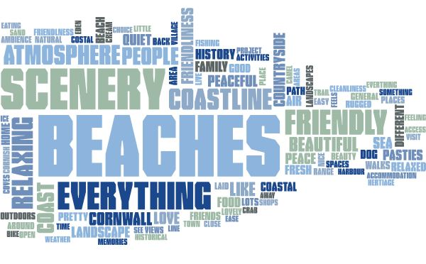
The natural beauty of Cornwall is key
Visitors were asked what they most liked about their visit to the county and the key themes are visualised in the word cloud below. The natural landscape such as beaches, coastline and scenery feature heavily alongside the general feel of being in Cornwall with words such as atmosphere, relaxing, friendly and peaceful being the main attractions.

Slide 91
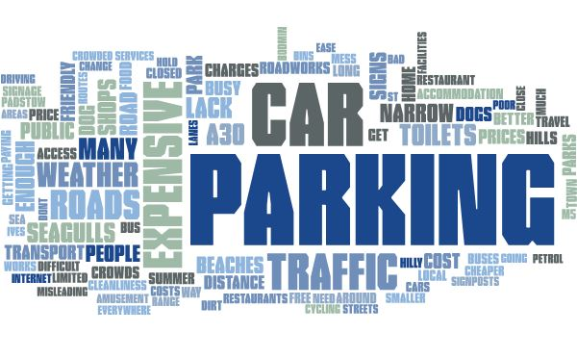
Car parking issues are confirmed
Visitors were asked what they least liked about their visit to the county or what could be improved and the key themes are visualised in the word cloud below. Car parking is a key issue alongside things such as traffic and road issues and cost.

Slide 92
Nearly all visitors will come again
96% of visitors stated that they were very likely (84%) or likely (12%) to visit Cornwall again in the future. This percentage has been relatively stable across the analysis years and is relatively similar across the analysis segments.
With such a large proportion of repeat visits virtually assured perhaps the key challenge is increasing the frequency of visits to Cornwall alongside continuing to attract a good proportion of new visitors.
How likely are you to visit Cornwall again in the future....? | Period | Area |  |  |  | Location |  |  | Visitor type
 | 2016/17 | West Cornwall | North Coast | South Coast | Bodmin/ Tamar Valley | Coastal | Urban | Rural | Day | Staying
Very unlikely | 1% | - | 2% | 1% | 2% | 2% | - | 2% | - | 1%
Unlikely | 1% | - | - | 2% | 2% | 1% | 1% | 1% | - | 1%
Neither unlikely nor likely | 2% | 2% | 1% | 1% | 4% | 2% | 2% | 2% | 2% | 2%
Likely | 12% | 11% | 10% | 14% | 12% | 11% | 16% | 11% | 12% | 12%
Very likely | 84% | 87% | 87% | 81% | 80% | 85% | 81% | 83% | 86% | 84%
Don't know | - | - | - | - | - | - | - | 1% | - | -
There was no comparable data available for previous years.

Slide 93
Future visits are more likely to be additional holidays
Those visitors likely to visit the county again were asked which types of trips they would consider in the future. Encouragingly 72% would consider a secondary/additional holiday in Cornwall and 43% a short break perhaps indicating that visitors are open to increasing the frequency of their visits.
And for which type(s) of trip(s) will you consider re-visiting Cornwall for? | Period | Area |  |  |  | Location |  |  | Visitor type
 | 2016/17 | West Cornwall | North Coast | South Coast | Bodmin/ Tamar Valley | Coastal | Urban | Rural | Day | Staying
Main holiday | 33% | 15% | 37% | 28% | 56% | 27% | 25% | 56% | 31% | 33%
Secondary /additional holiday | 72% | 83% | 72% | 68% | 66% | 71% | 78% | 71% | 40% | 76%
Short break | 43% | 28% | 56% | 36% | 51% | 42% | 38% | 52% | 73% | 40%
There was no comparable data available for previous years.

Slide 94
Coastline appeal confirmed
Visitors were asked which words/phrases they associated with Cornwall from a pre-defined list to better understand visitors main connections with the county and also offer insights for potential marketing opportunities.
Associations with the coast were again highlighted in the top three selected things selected by visitors but local food and drink, unspoilt countryside and unique landscape also featured highly. Overall this confirms the major importance of the Cornish natural environment as well as a local/unique connection with food and drink in the county.
There was no comparable data available for previous years.

Slide 95
Surfing and TV are further connections
Other words/phrases associated with the county to a lesser degree are shown in the chart below. Also associated by a third or more of visitors are the Cornish surf culture, distinctive heritage and the TV shows Doc Martin and Poldark.
Cornwall is also considered to be a dog friendly destination by 38% of visitors opening it up to the huge number of dog owners in the country for holidays with their pets.
There was no comparable data available for previous years.

Slide 96
Cornwall Visitor Survey 2016/17
The South West Research Company Ltd
www.tswrc.co.uk

